Slide 1

Week13
🦄
OOP
🦜🦜🦜🦜🦜🦜🦜🦜🦜🦜🦜🦜🦜
WARMUP
what is object-oriented programming?
are you an object-oriented programmer?
do you know anything about hackers?
can you jam with the console cowboys in cyberspace?
ANNOUNCEMENTS
doughnuts on wednesday

Slide 2
do you know anything about hackers? 🎥

Slide 3
🍩🍩 P
P

Slide 4
indiana, let it go 🎥

Slide 5

OOP ?

Slide 6
object (instance of a class)

Slide 7
anatomy of a class (1/2)
class ClassName {
VariableOneType variableOne;
...
FunctionOneReturnType functionOneName(...) { ... }
...
}
a class is (a blueprint for) a lil chunk of data that you can make elsewhere
a class may have any number of variables (fields)
int foo; // objects of this class have an int called foo
a class may have any number of functions (methods)
int bar() { ... } // objects of class have function bar

Slide 8
anatomy of a class (2/2)
class Point {
// instance variables
double x;
double y;
// constructor
Point(double x, double y) { ... }
// instance methods
double distance(Point otherPoint) { ... }
...
}

Slide 9
an object is an instance of a class // p is a reference to an instance of the Point class // p is an instance of the Point class // p is a Point object // "p is a Point" Point p = new Point();

Slide 10
object-oriented programming (OOP) note: jim maybe has opinions but who's to sayyy

Slide 11
object-oriented programming (OOP)
object-oriented programming means thinking in terms of nouns
"how can i break down this problem into classes/objects?"

Slide 12
object-oriented programming (OOP)
object-oriented programming is NOT just having classes/objects
recall, a class is just (a blueprint for) a lil chunk of data
rather, OOP means my problem-solving is oriented around objects
...instead of, for example, data (data-oriented design)
...functions (functional programming)

Slide 13
object-oriented programming
example: to implement an Object-Oriented PostScript interpreter...
class PSInterpreter
class PSProgram
class PSStack
class PSMap
class PSBuiltinFunction
class PSTwoArgumentBuiltinFunction extends PSBuiltinFunction
class PSAddFunction extends PSTwoArgumentBuiltinFunction
class PSSubFunction extends PSTwoArgumentBuiltinFunction
class PSMulFunction extends PSTwoArgumentBuiltinFunction
class PSDivFunction extends PSTwoArgumentBuiltinFunction
...

Slide 14
unified modeling language (UML) diagram
PSBuiltinFunction
PSTwoArgumentBuiltinFunction
PSAddFunction
PSSubFunction
PSDivFunction
PSMulFunction

Slide 15
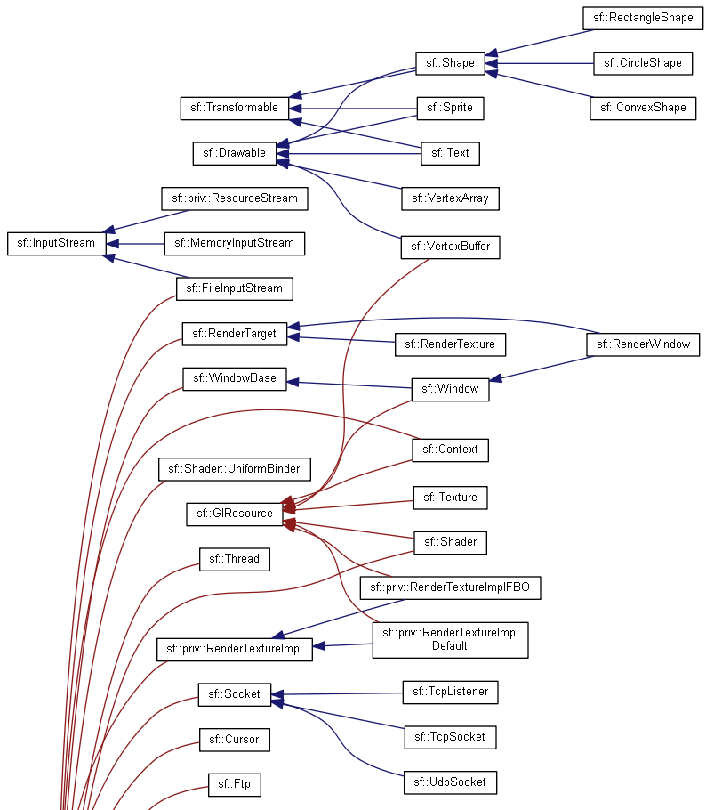
real-world example:
SMFL

Slide 16
note that we still haven't written any actual code we've made a plan for how to break the problem into objects

Slide 17
note: it can be hard to break problems into objects
Consider a very basic question: should a Message send itself? ‘Sending’ is a key thing I wish to do with Messages, so surely Message objects should have a ‘send’ method, right? If Messages don’t send themselves, then some other object will have todo the sending, like perhaps some not-yet-created Sender object. Or wait, every sent Message needs a Recipient, so maybe instead Recipient objects should have a ‘receive’ method. This is the conundrum at the heart of object decomposition. Every behavior can be re-contextualized by swapping around the subject, verb, and objects. Senders can send messages to Recipients; Messages can send themselves to Recipients; and Recipients can receive messages. --Brian Will

Slide 18
so

Slide 19
it is very hard to break a problem into objects

Slide 20
but

Slide 21
it is also very popular to break a problem into objects

Slide 22
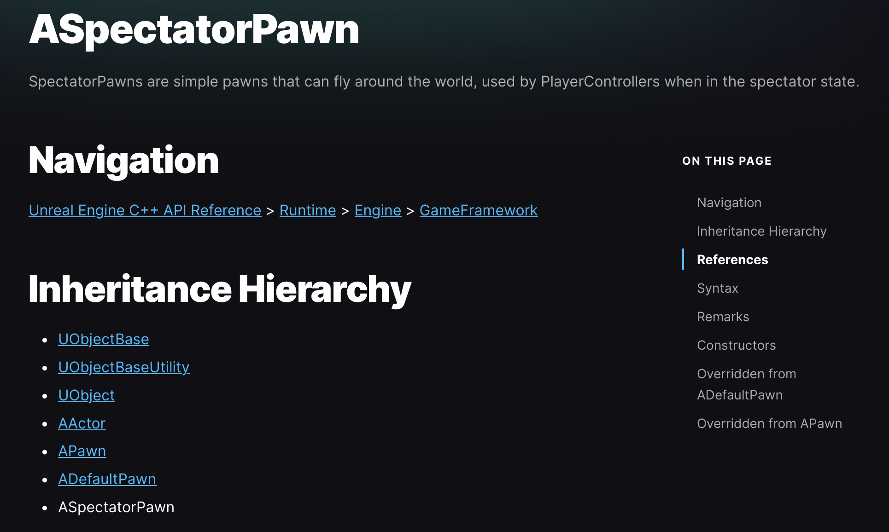
example: Unreal Engine API

Slide 23
example: PyTorch

Slide 24
so let's learn some OOP 🙂👍

Slide 25
inheritance

Slide 26
one class can inherit from another
a child class (derived class, subclass) inherits from its parent class (base class, superclass)
a child inherits (gets, has) its parents' variables and functions
// Inheritance: HW13 is a Cow (app)
class HW13 extends Cow {
public static void main(...) {
while (beginFrame()) {
...
}
}
}
class Cow {
static boolean beginFrame(...);
static double mouseX;
static double mouseY;
static boolean keyPressed(...);
...
}

Slide 27
inheritance is convenient, but NOT fundamental (except sometimes in Java)
instead of extending a class, we can store a reference to an instance of it
this is called "composition"
we will have to use the dot operator (a lot) more, but c'est la vie; they're fundamentally the same thing*
// Inheritance: HW13 is a Cow
class HW13 extends Cow {
public static void main(...) {
while (beginFrame()) {
...
}
}
}
// Inheritance: HW13 has a Cow
class HW13 {
static Cow cow;
public static void main(...) {
while (cow.beginFrame()) {
...
}
}
}

Slide 28
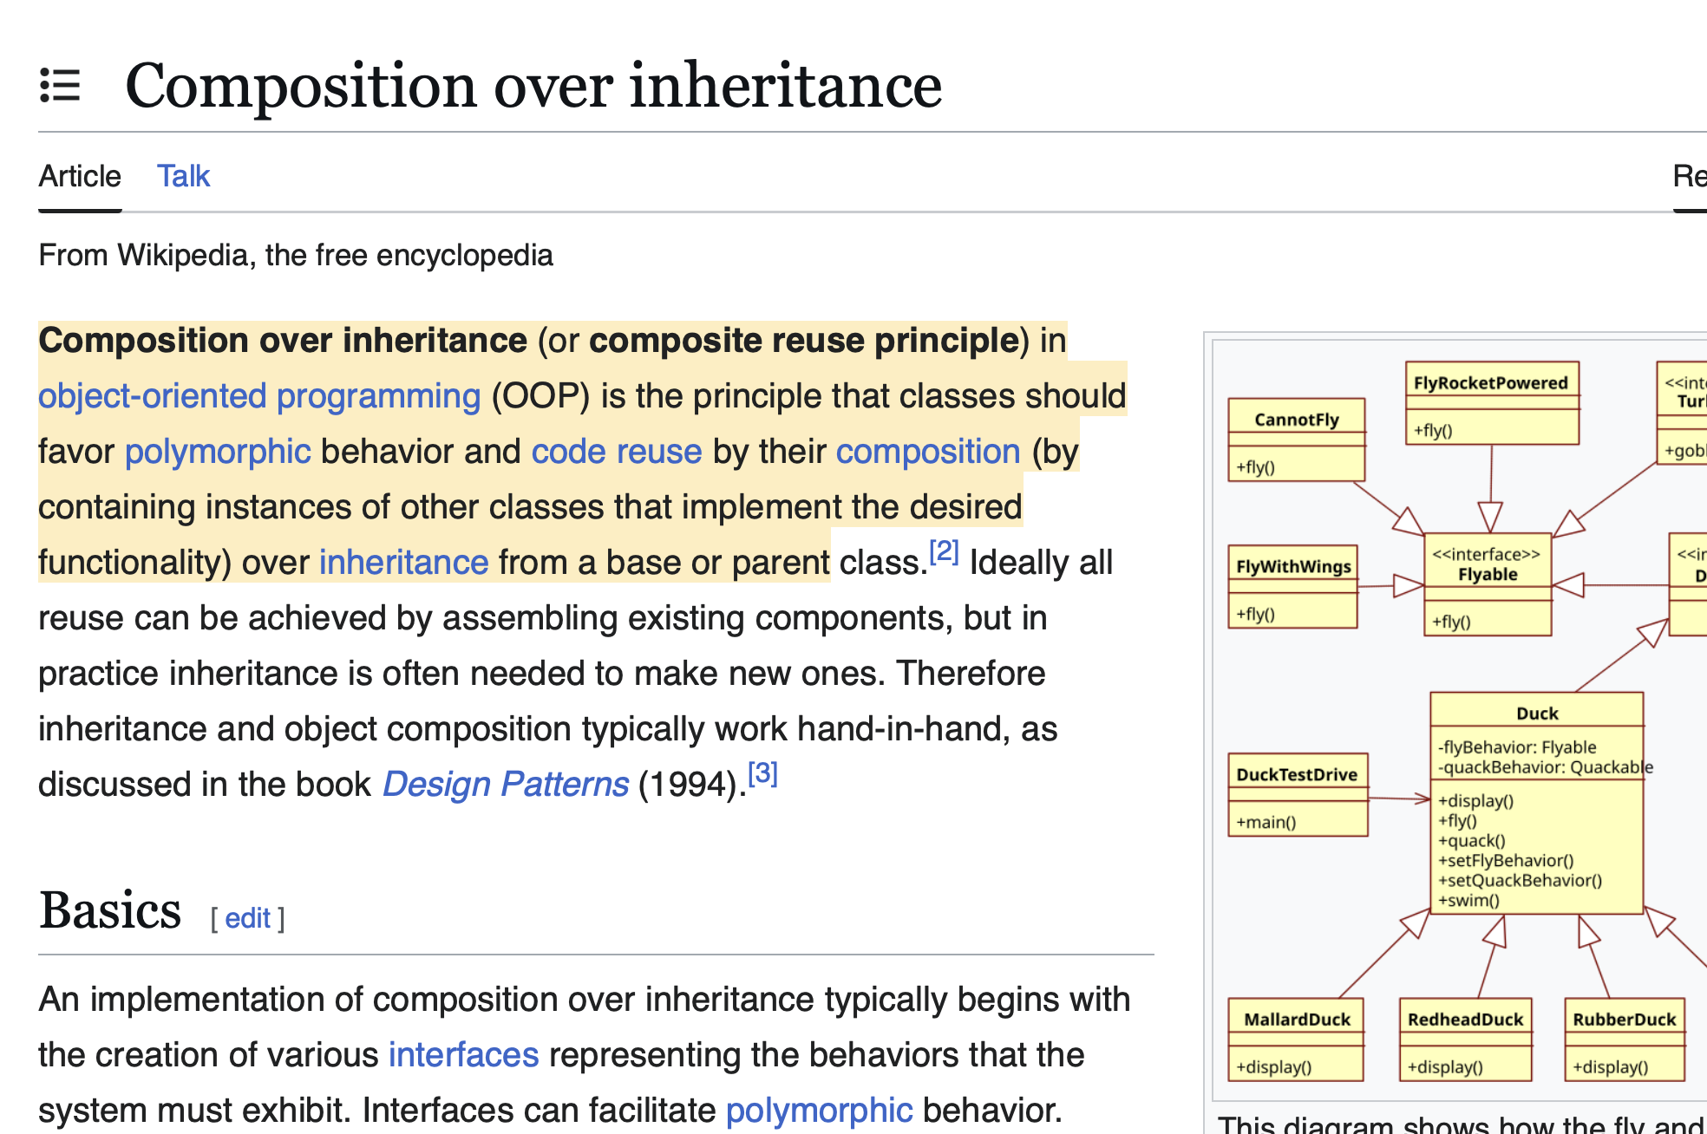
*sidenote: some people don't think agree with me that composition and inheritance are the same thing

Slide 29
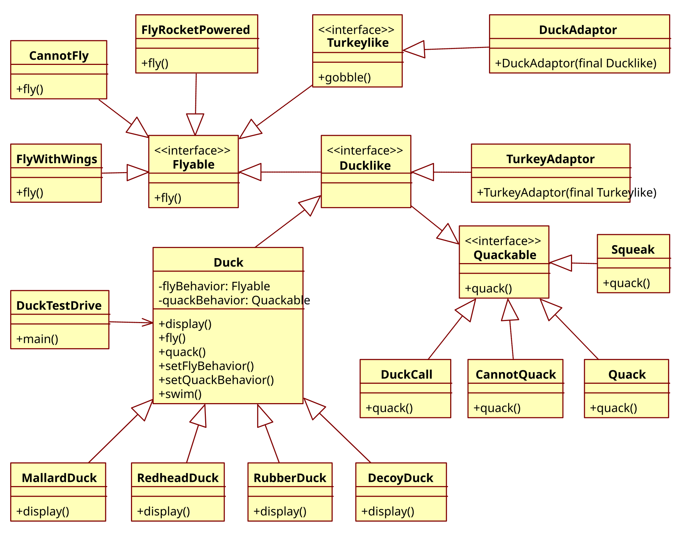

Slide 31
🦃

Slide 32
gobble gobble

Slide 33
anyway.

Slide 34
the fundamental point is that maybe it's nice to reuse code

Slide 35
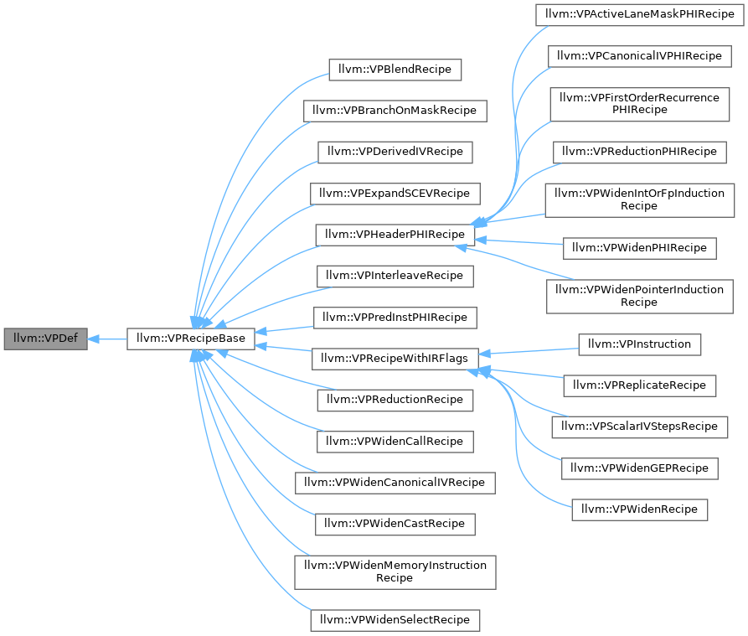
maybe

Slide 36
final note: inheritance doesn’t simplify a problem so much as i t s p r e a d s i t o u t (and spreads it around?)

Slide 37
down the rabbit hole...
public class ArrayList<E>

Slide 38
down the rabbit hole...
public class ArrayList<E> extends AbstractList<E>
implements List<E>, RandomAccess,
Cloneable,
java.io.Serializable

Slide 39
down the rabbit hole...
public abstract class AbstractList<E> extends AbstractCollection<E>
implements List<E> {

Slide 40
down the rabbit hole...
public abstract class AbstractCollection<E> implements Collection<E> {

Slide 41
down the rabbit hole...
public interface Collection<E> extends Iterable<E> {

Slide 42
down the rabbit hole...
public interface Iterable<T> {
/**
* Returns an iterator over a set of elements of type T.
*
* @return an Iterator.
*/
Iterator<T> iterator();
}

Slide 43
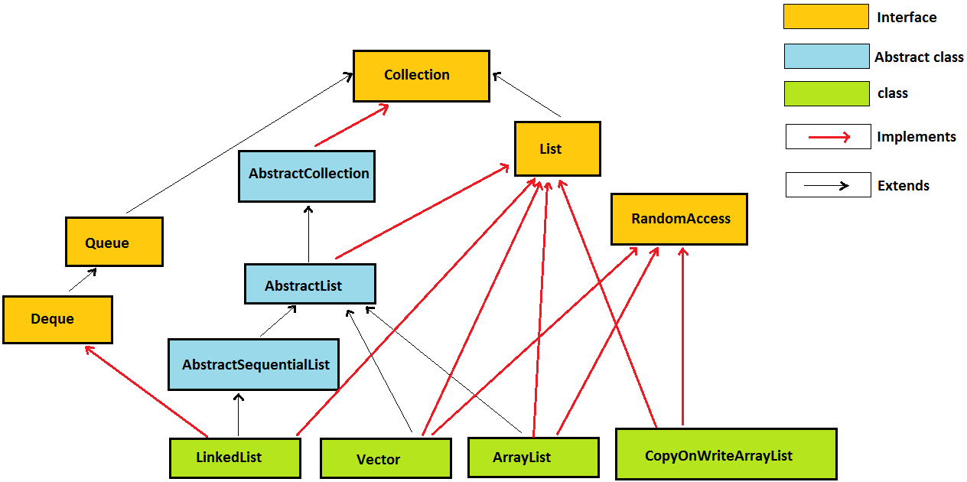
down the rabbit hole...

Slide 44
gobble gobble

Slide 45
encapsulation

Slide 46
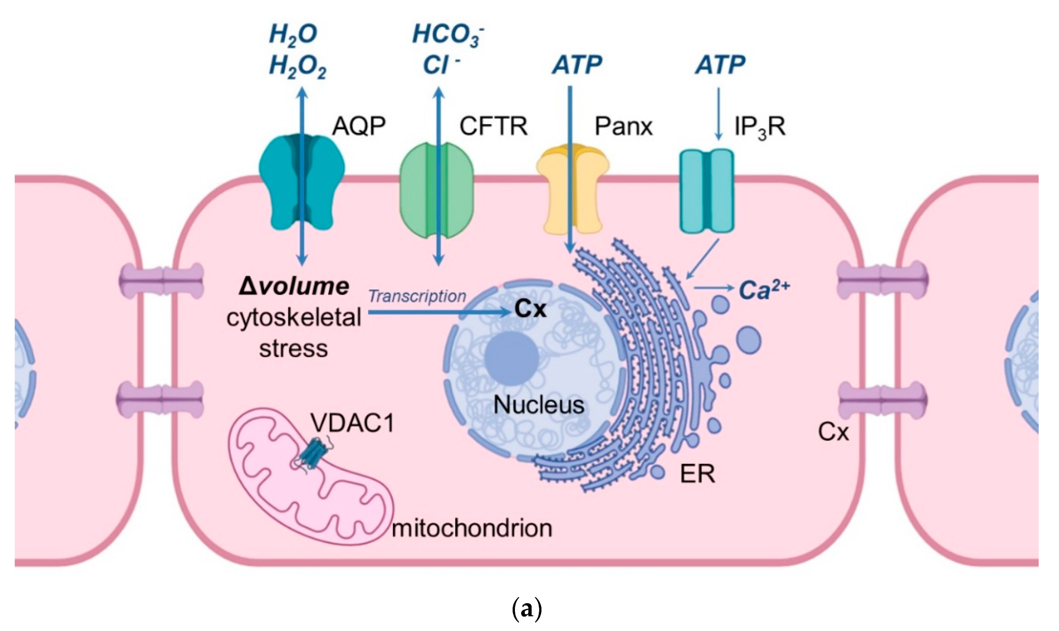

Slide 47
encapsulation
encapsulation is the idea that a class should be like a "capsule"
the variables inside the capsule should be private
users of the class CANNOT touch them
for its users, the class should expose safe, public functions

Slide 48
void put(KeyType key, ValueType value) { ... }
ValueType get(KeyType key) { ... }
int size() { return this._size; }
ArrayList<KeyValuePair>[] buckets;
int _size;
encapsulated hashmap

Slide 49
note: this probably makes sense the typical user of a hashmap shouldn't be messing with the private array (and perhaps the exceptional user should write their own hashmap)

Slide 50



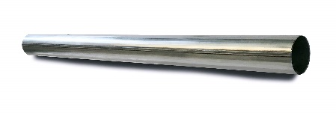

big idea: encapsulation can hide away messy, dangerous details
note: this is just a metaphor;
do NOT play with fire

Slide 51
however encapsulation can maybe be taken too far
bullet.age++;
bullet.setAge(bullet.getAge() + 1);
bullet.ageUp(); // ?

Slide 52
OOP considered maybe mildly frictious to prototyping

Slide 53
final note: encapsulation doesn’t add functionality encapsulation removes functionality

Slide 54
special topic: conway's law

Slide 55
spicy take 🌶️

Slide 56
iterators

Slide 57
cool gradient in cow

Slide 58

A N N O U N C E M E N T S
check HW13 page for more resources (in ~4 hrs)
today is Fun Kahoot Final Review
friday is the last day of class
W A R M U P
what is a computer program?
what is programming?
what is a data structure?
T O D A Y
review

Slide 59

ANNOUNCEMENTS
check HW13 page for more resources (in ~4 hrs)
today is Fun Kahoot Final Review
friday is the last day of class
WARMUP
what is a computer program?
what is programming?
what is a data structure?
TODAY
review

Slide 60
record LEC-02

Slide 61
what has this course been about?

Slide 62
data structures & big O runtime as i review... use the big O runtimes to remind yourself how the data structures work 🙂👍

Slide 63
data structures

Slide 64
what is the most important data structure?

Slide 65
quadtrees

Slide 66
just kidding

Slide 67
it's arraaaaaaays.

Slide 68
(also trees, but mostly arrays.)

Slide 69
an array is a sequence of contiguous elements
the length of an array is fixed
⏱️ creating an array takes O(n) time, where n is the length of the array
because the elements are all the same size and all right next to each other, accessing an array is FAST
⏱️ getting the value of the i-th element of an array takes O(1) time
⏱️ setting the value of the i-th element of an array takes O(1) time

Slide 70
a string is internally an array of characters
⏱️ adding (concatenating) two strings of length n is an O(n) operation
we have to make a new string of length 2n, which is O(n)

Slide 71
we used an array to implement an array list, which automatically resizes itself
⏱️ when the internal private array is not full, adding is O(1)
⏱️ when the internal private array is full, adding is O(n)
have to make a new array (of, for example, twice the length) and copy

Slide 72
we used an array list to implement a stack and a queue
stacks and queues restrict the way we access a sequence of elements
a stack can push an element to the top & pop the top element
🥞
a queue can add an element to the back & remove the front element
🚶‍♀️🚶‍♂️🚶‍♀️🚶‍♀️🚶‍♂️🚶‍♂️🚶‍♂️

Slide 73
we can use an array of array lists to implement a hash map
⏱️ putting (adding) a key-value pair into a hash map is O(1)
it's a "slow O(1)," which involves hashing the key
in separate chaining (like we did in class), this takes us to a bucket
if the key was already in the bucket, we overwrite its value
otherwise we add the key-value pair to the bucket
⏱️ get key's value from a hash map is O(1)

Slide 74
arrays. (also trees, but mostly arrays.)

Slide 75
a node is a little teeny class
a node can store data (like a value) as well as references to other nodes

Slide 76
a chain of nodes is a linked list
a linked list has the same interface as an array list, but acts very differently
⏱️ adding to the end of a singly linked list is O(n)
⏱️ getting an element by index is O(n) ☹

Slide 77
a branching chain of nodes (with no cycles) is a tree
each node has references to its children
a node's children & its children's children & its children's children's children, ... are called its descendants
the node with no parents is called the root

Slide 78
a tree where each node can only have up to two children is a binary tree
a node in a binary tree can have a left child and a right child
the height of a balanced binary tree is O(log n)

Slide 79
binary search trees and heaps are special kinds of binary trees
in a binary search tree, each node's value is greater than the values of all of its left descendants and less than the values of all of its right descendants
⏱️ searching a balanced binary search tree is O(log n)
in a max binary heap, each node's value is greater than the values of both of its children
⏱️ adding an element to a max binary heap is O(log n)
🐡 add to the first empty slot and swim up
⏱️ removing the max element (root) from a max binary heap is O(log n)
⚓ swap the last element with the root and sink down

Slide 80
what does it all mean?

Slide 81
here's my attempt to summarize the course in a few sentences

Slide 82
136
data means numbers (letters are numbers, colors are numbers, ...)
there's no one perfect way to organize your data
it depends on the problem
to find a good data structure for a particular problem, we can...
...just try an array first; if that works, great, we're done 🙂👍
...compare different data structures using math (big O notation)
...in terms of speed
...in terms of space
...compare different data structure's usage code
...an array might be fast, but is it pleasant?

Slide 83
136 was us moving from finding a solution... ...to finding a good solution

Slide 84
and starting to build the tools and confidence to solve bigger problems

Slide 85
like the final project 😬👍

Slide 86
what does it all mean?

Slide 87
what does it all meme?

Slide 88


Slide 89
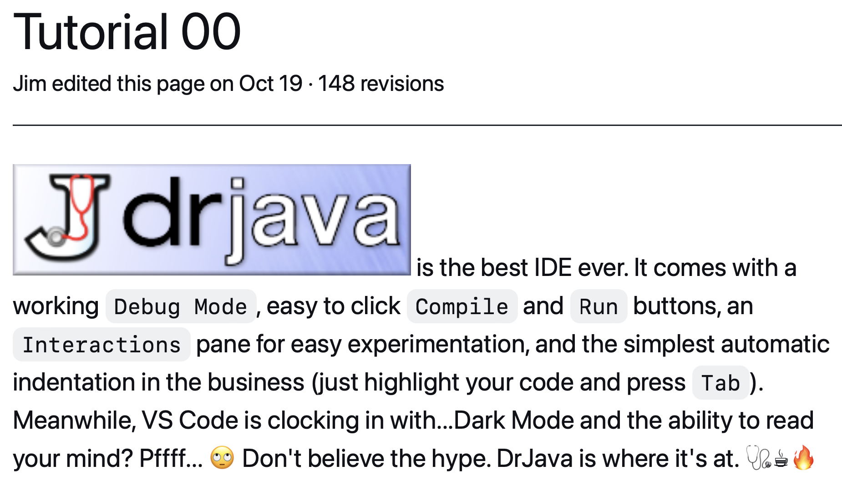

Slide 90
increment operator
to "increment" means to increase the value of a number by one
i = i + 1;
i += 1;
the pre-increment ++i increments i and returns the new value of i
j = ++i; // i = i + 1;
// j = i;
the post-increment i++ increments i and returns the old value of i
j = i++; // j = i;
// i = i + 1;

Slide 91
decrement operator
to "decrement" means to decrease the value of a number by one
i = i - 1;
i -= 1;
the pre-decrement --i decrements i and returns the new value of i
j = --i; // i = i - 1;
// j = i;
the post-decrement i-- decrements i and returns the old value of i
j = i--; // j = i;
// i = i - 1;

Slide 92
story time ☕️

Slide 93


Slide 94
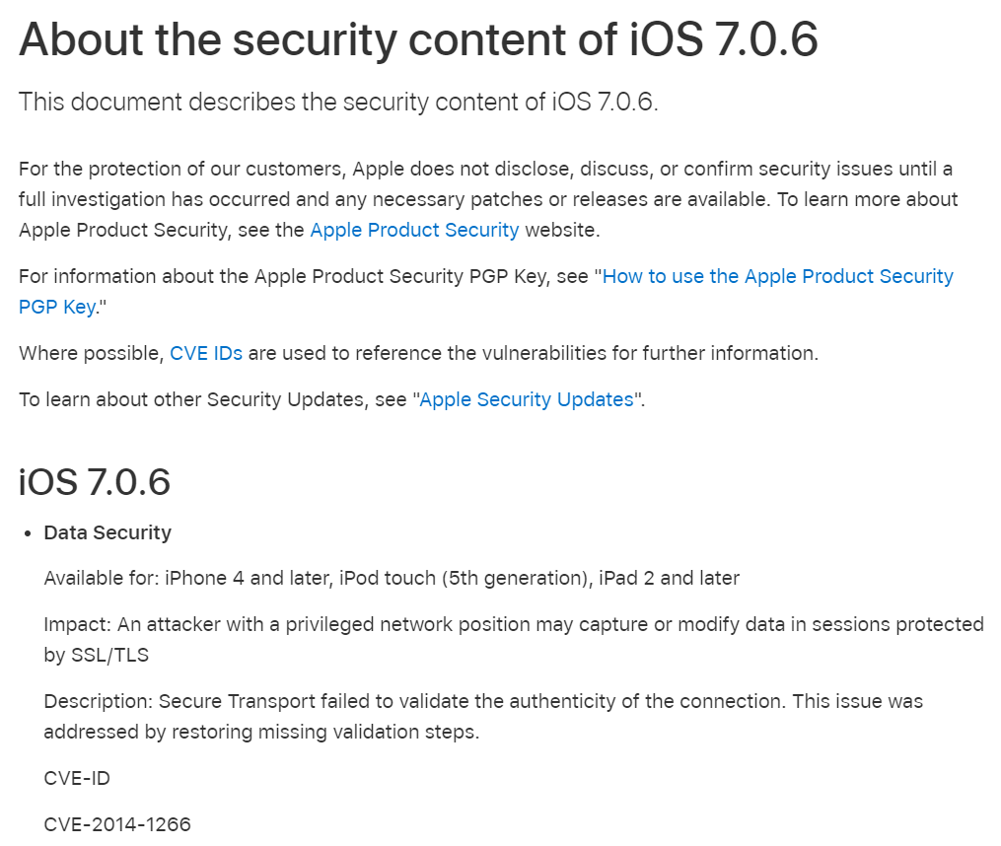

Slide 95
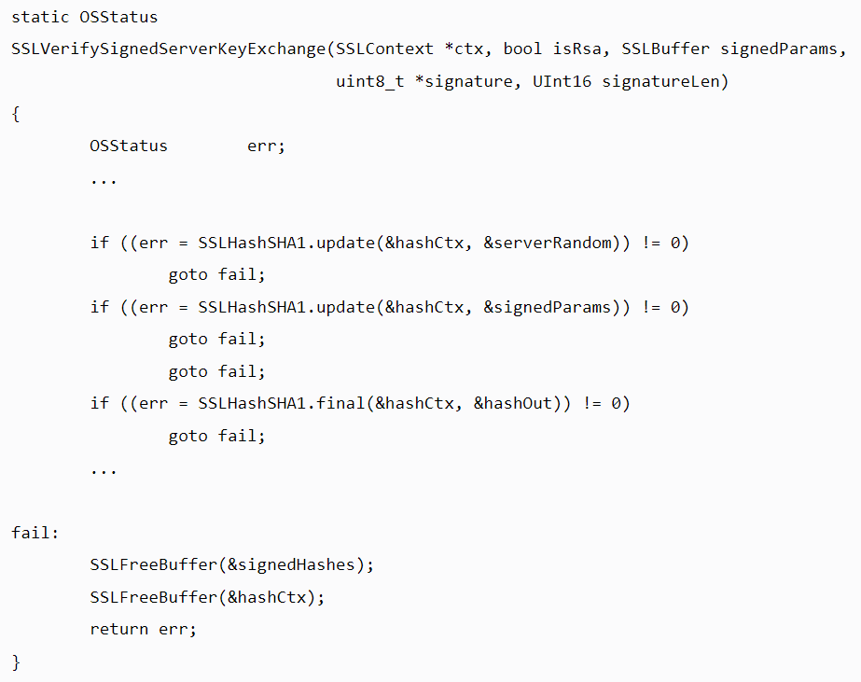

Slide 96
{
}
goto fail;

Slide 97
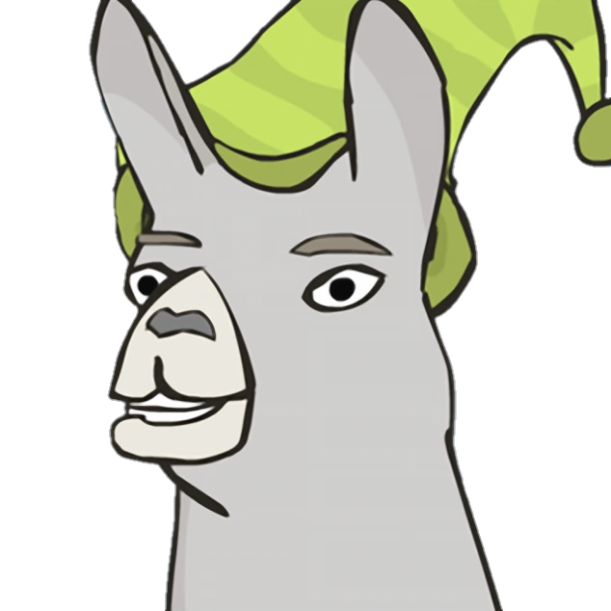
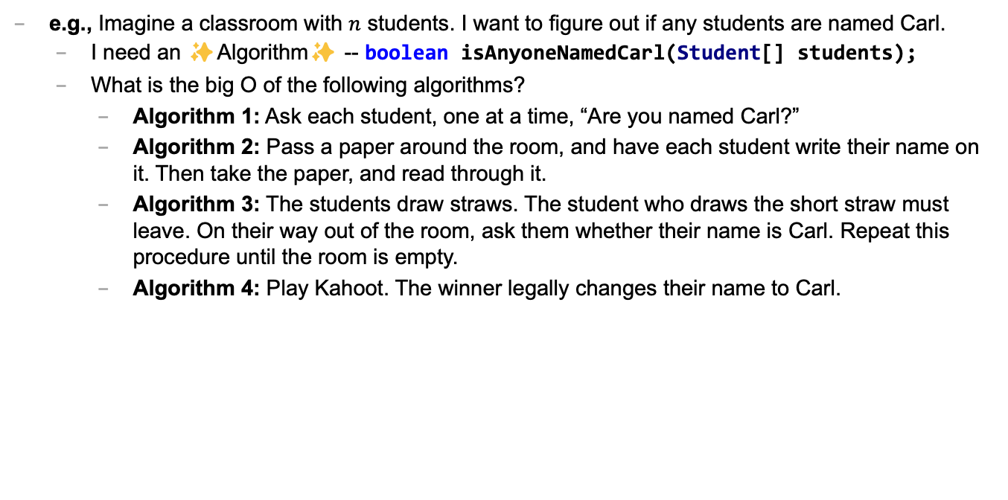
Caaaaaaaaaaaarl
e.g., Imagine a classroom with $n$ students. I want to figure out if any students are named Carl.
I need an ✨Algorithm✨ -- boolean isAnyoneNamedCarl(Student[] students);
What is the big O of the following algorithms?
Algorithm 1: Ask each student, one at a time, “Are you named Carl?”
Algorithm 2: Pass a paper around the room, and have each student write their name on it. Then take the paper, and read through it.
Algorithm 3: The students draw straws. The student who draws the short straw must leave. On their way out of the room, ask them whether their name is Carl. Repeat this procedure until the room is empty.
Algorithm 4: Play Kahoot. The winner legally changes their name to Carl.

Slide 98
mental model of an array
elements live in equally-sized boxes all right next to each other
🟩🟩🟩🟩🟩🟩🟩🟩
the array itself lives "in memory"

Slide 99

mental model of an array
elements live in equally-sized boxes all right next to each other
🟩🟩🟩🟩🟩🟩🟩🟩
the array itself lives "in memory"

Slide 100
☠ example: bad very bad broken array copy

Slide 101
☠ example: bad very bad broken array copy
import java.util.*;
class Main {
public static void main(String[] arguments) {
int[] source = { 3, 4, 5 };
int[] destination = source;
source[0] = 7;
System.out.println(Arrays.toString(source));
System.out.println(Arrays.toString(destination));
}
}

Slide 103
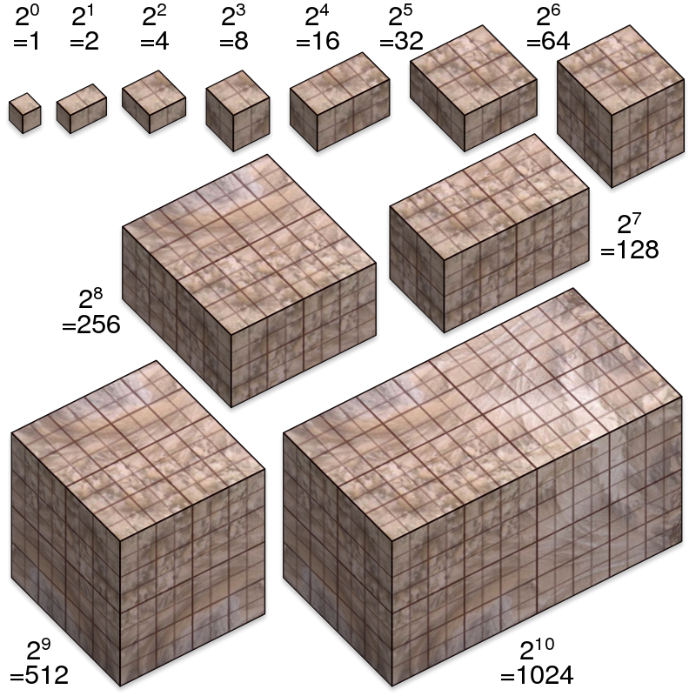
not broken
broken
developing one thing at a time

Slide 104
not broken
A is broken
B is broken
A and B are both broken
developing two things at a time

Slide 105

asymptotic bug-finding time

Slide 106
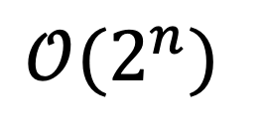
$$𝒪(2^{n})$$
gl;hf 🙂👍

Slide 107
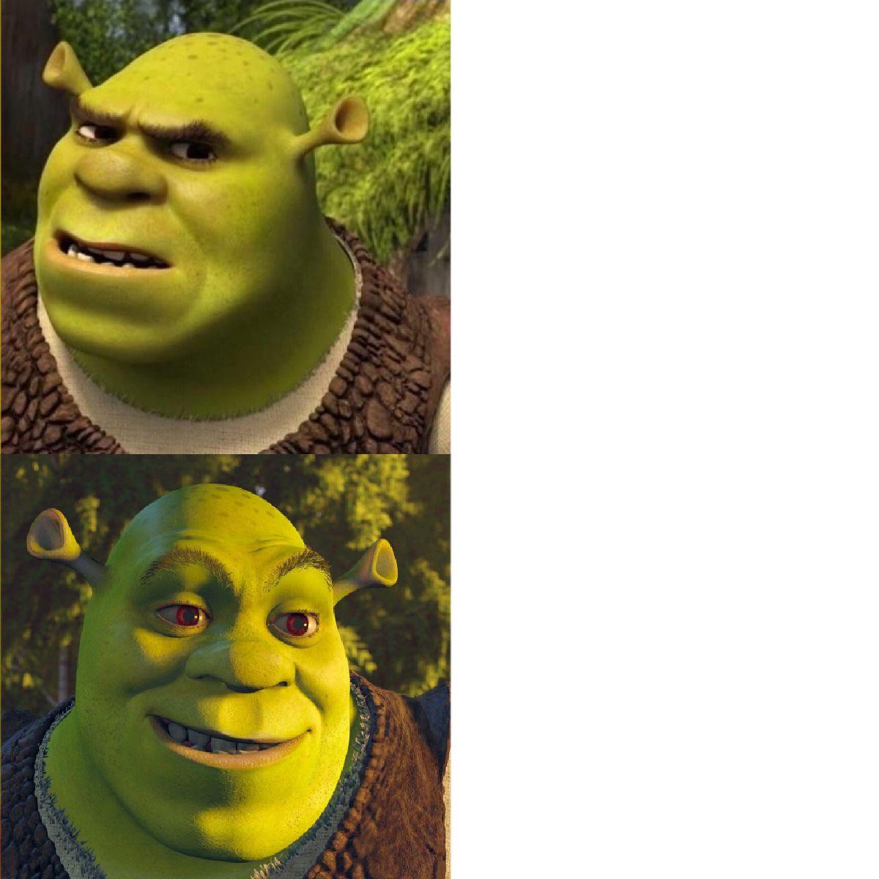
code up the entire program without compiling it
compile early; compile often

Slide 108

compilers

Slide 109

DOCUMENTATION

Slide 110
Tungsten break 😀 did you know the density of Tungsten is 19.25 g/cm³? Gold is 19.32 g/cm³ did you know Tungsten is really hard? Tungsten alloys can be as hard as Sapphire! that's really hard! Tungsten is expensive (that cube is $60) but not like...that expensive what could YOU do with Tungsten?

Slide 111
if (token.type == 2) {
...
}
if (token.type == Token.TYPE_STRING) {
...
}

Slide 112

previously, on Hans the Parrot

Slide 113
🐧🦉
🦜
🐤
🪣
🪣
🐦
🦆🐓🦃
🪣
🪣
🪣
Joe Kahoot Cheep Hans Doug Io Gary Max
0
1
2
3
4
👮

Slide 114
is this Hans?
buckets[bucketIndex].get(i).key.equals("Hans")?
🐧🦉
🦜
🐤
🪣
🪣
🐦
🦆🐓🦃
🪣
🪣
🪣
Joe Kahoot Cheep Hans Doug Io Gary Max
0
1
2
2
3
4
👮
which bucket is Hans in?
Math.floorMod("Hans".hashCode(), buckets.length)
map.get("Hans")

Slide 115
☃️

Slide 116
🐍
3.0
head
|
|
head.next
|
|
|
|
|
null

Slide 117
"the stack"
local variable primitives & references to Objects
undefined by default (will NOT compile if used)
"the heap"
the actual Objects (arrays and String's count as Objects)
cleared to 0 or null by default

Slide 119
LinkedList list;
{
Node node;
String string;
list = new LinkedList();
node = new Node();
string = "Hans";
node.value = string;
list.head = node;
node = new Node();
string = "Parrot";
node.value = string;
list.head.next = node;
}
list
0x11111111
0x22222222
0x88888888 0x33333333
0x99999999 null
H a n s
P a r r o t

Slide 120
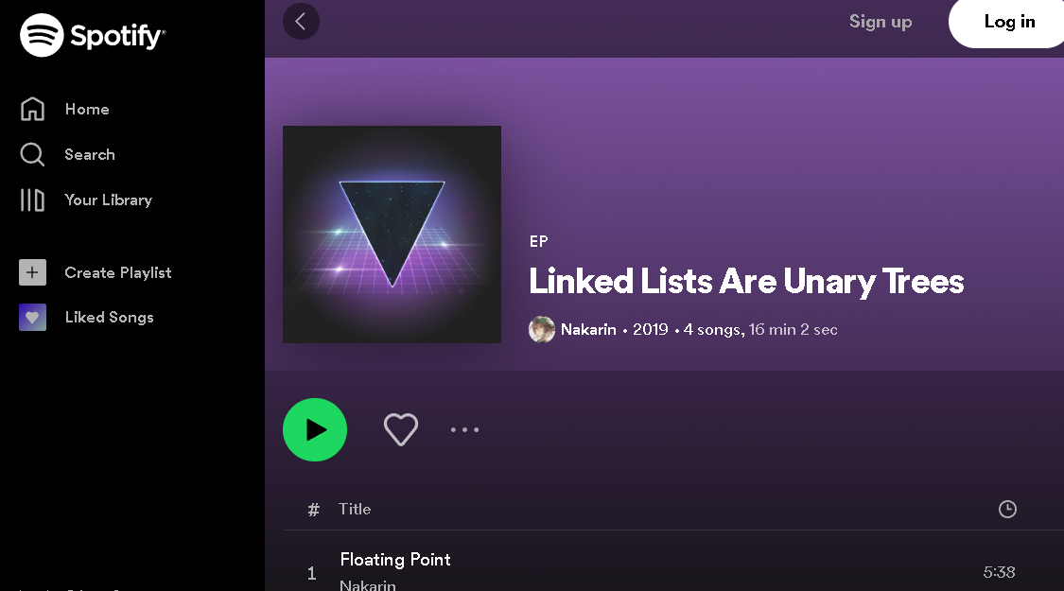
can be seen as

Slide 121
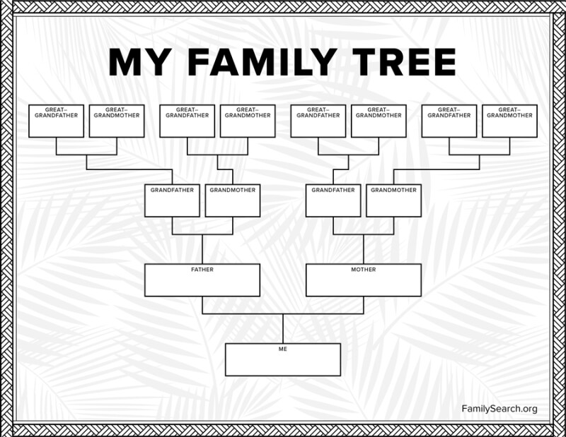

Slide 123
jim
careful: these nodes are
the children of the node with value jim
jim's mom
jim's dad
jim's mom's mom
jim's mom's dad
jim's dad's mom
jim's dad's dad

Slide 124



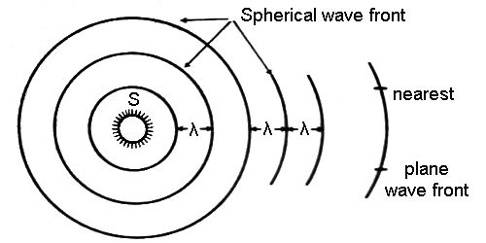
breadth-first vs. (pre-order) depth-first
"a persistent, optimistic, very thorough worm" –Mark Hopkins

Slide 125
quadtree rabbit hole 🐰

Slide 126

2 * 3
+ 4
who's that
traversal order?
+
in-order!
*
4
2
3

Slide 127
[ 7 4 2 3 6 1 8 5 9 ]
7
4
2
3

Slide 128
[ 7 4 2 3 6 1 8 5 9 ]
7
4
2
🐡
3
6

Slide 129
[ 7 6 2 3 4 1 8 5 9 ]
7
6
💦
2
3
4

Slide 130





extension: priority queue
priority 9
priority 1
priority 1
priority 5

Slide 131

extension: priority queue
priority 999
priority 9
priority 1
priority 1
priority 5

Slide 132
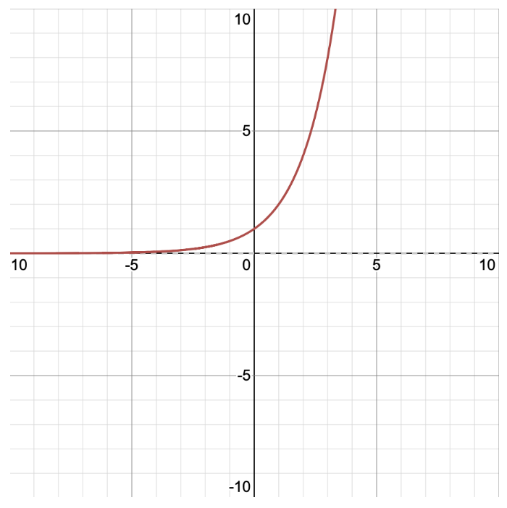
y = 2^{x} x = log₂ y
y
x

Slide 133
y = 2^{x} x = log₂ y
y
x

Slide 134

enumerate

Slide 135
🙂👍

Slide 136
🥲👍

Slide 137
homework ✨ how do the post-midterm homeworks work? can you "run them by hand?"

Slide 138


Slide 139


Slide 140
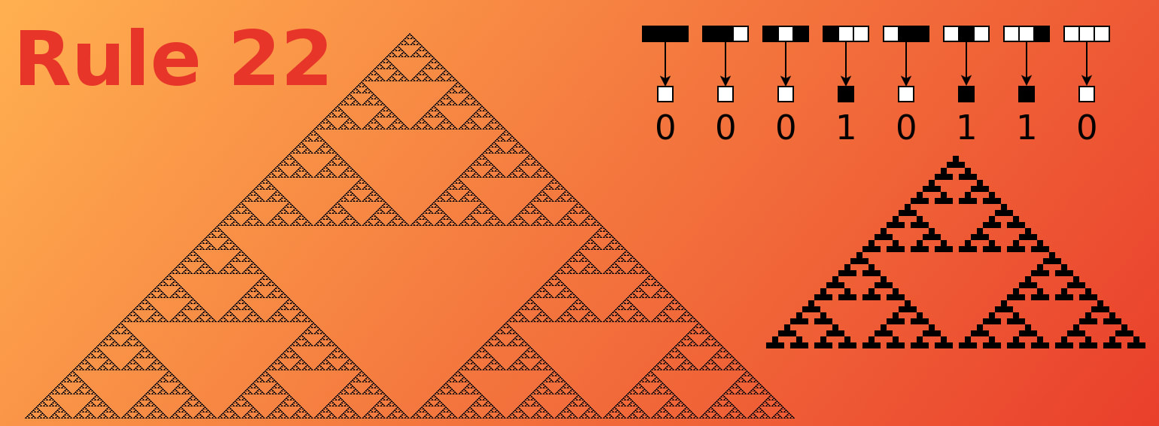

Slide 141


Slide 142


Slide 143

how do you interpret PostScript?

Slide 144

how do you generate text?

Slide 145
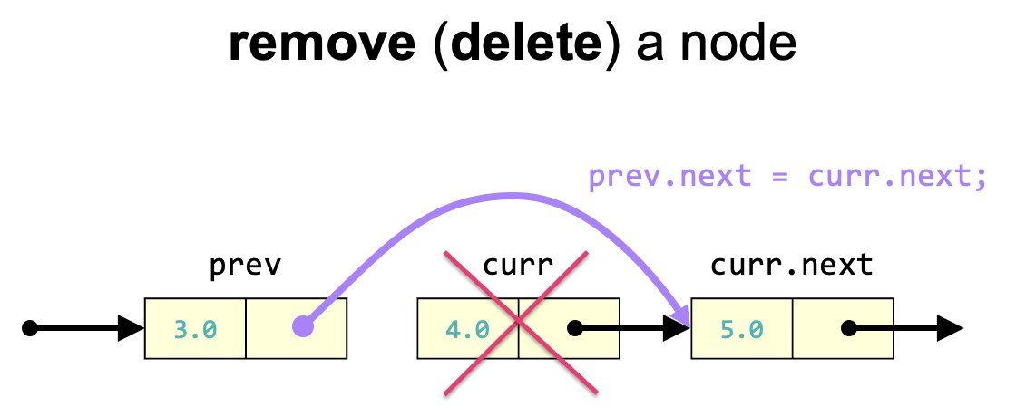
how do you create
& change a linked list?

Slide 146
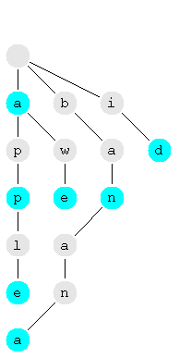
how do you store a vocabulary in a tree (trie)?

Slide 147
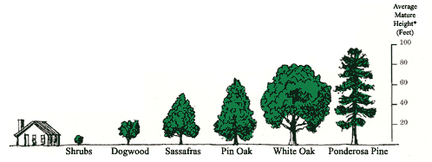

Slide 148
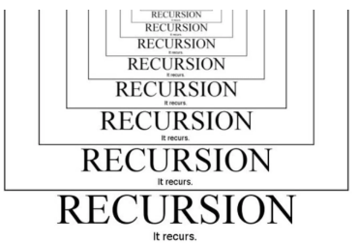
what is the big O runtime of a piece of code?

Slide 149
kahoot

Slide 150
Week?12🦃
graphs
amazing stackoverflow answer
boggle?
gradient descent

Slide 151
graphs

Slide 152
graph

Slide 153
a directed graph is a super general linked list
a node in a graph has references to any number of other nodes
nodes (vertices) are drawn as circles
references (edges) are drawn as arrows

Slide 154
an undirected graph has line segments instead of arrows

Slide 155
is it a graph?

Slide 156
time for everyone's favorite home game...

Slide 157
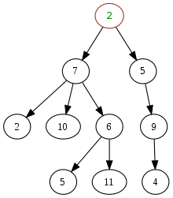
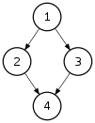
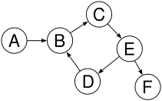
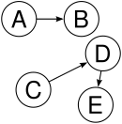

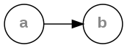
is it a tree?
graph
yes
yes
tree rules
one node with zero parents
no node with more than one parent
no cycles
is connected
yes
yes
yes
yes
yes

Slide 158
yes

Slide 159
examples

Slide 160
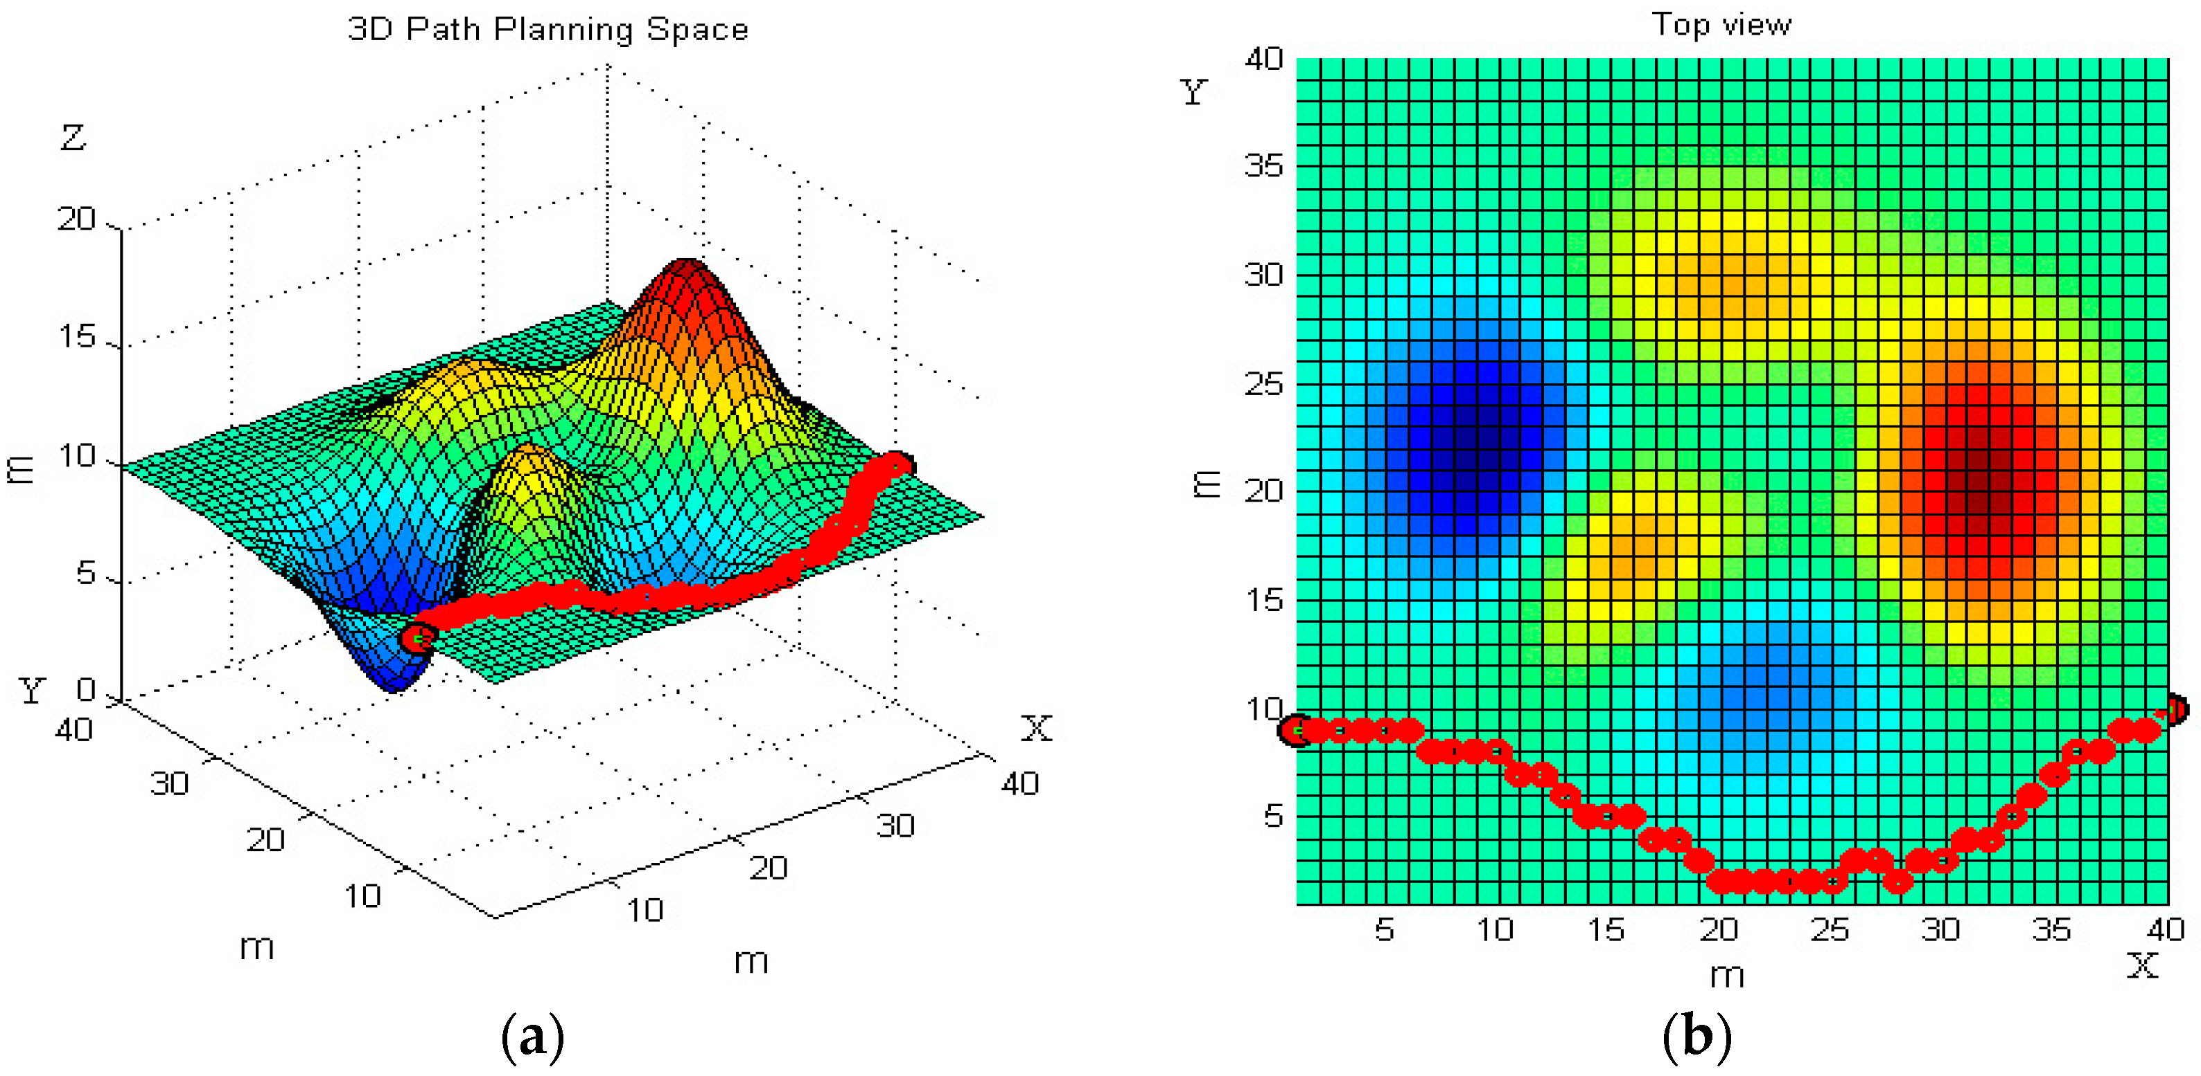

path planning

Slide 161
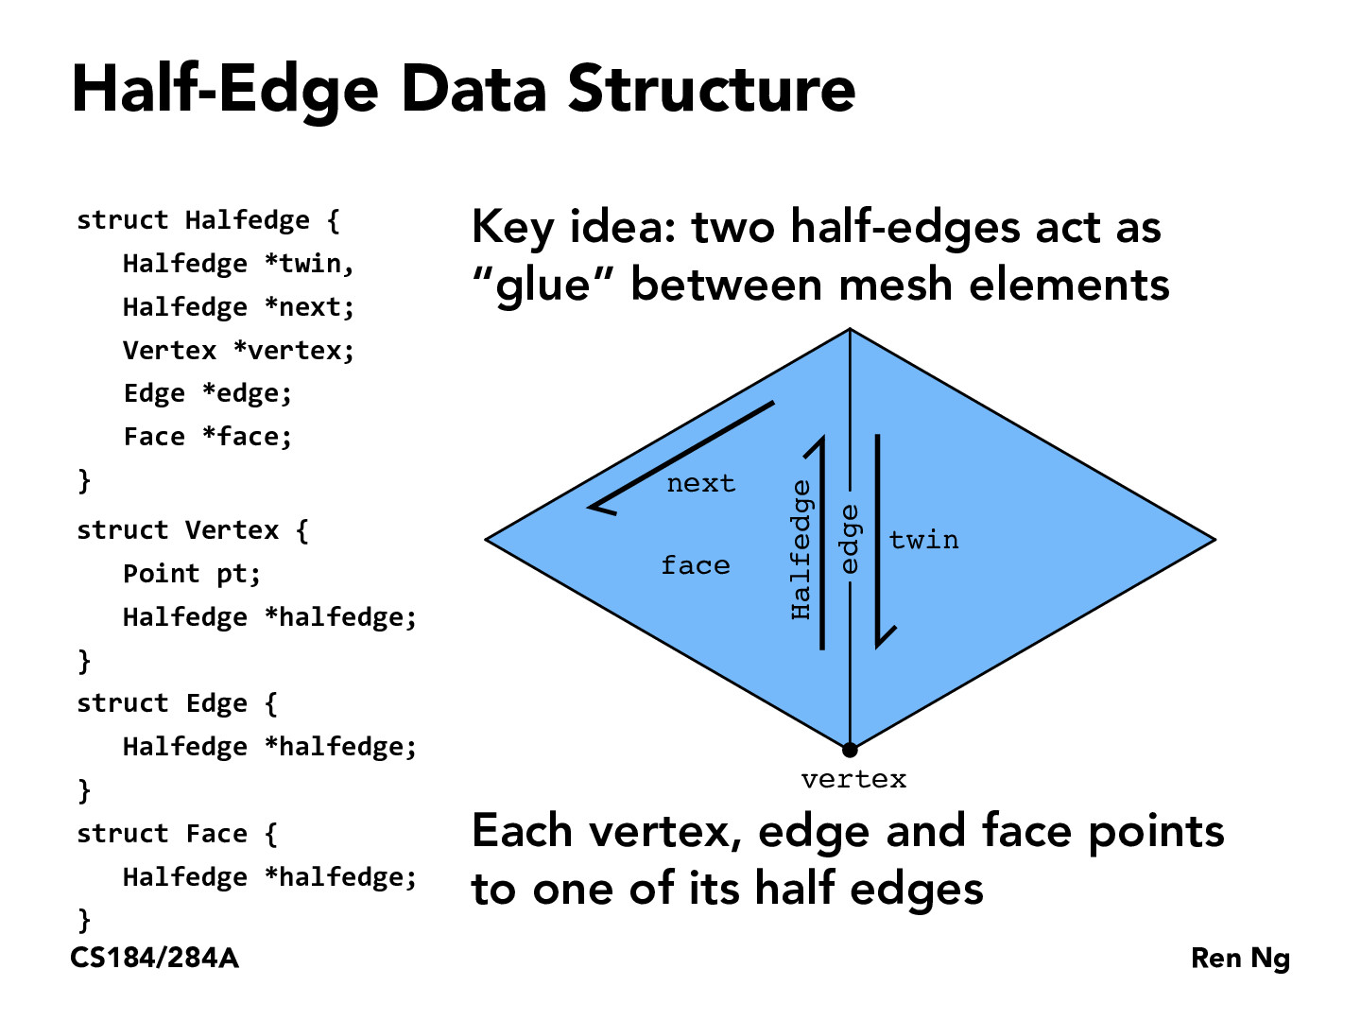
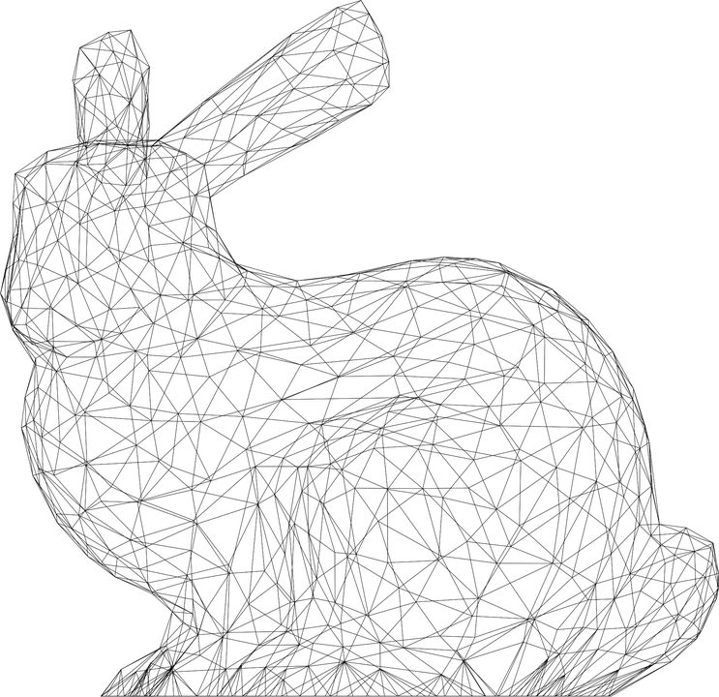

Slide 162
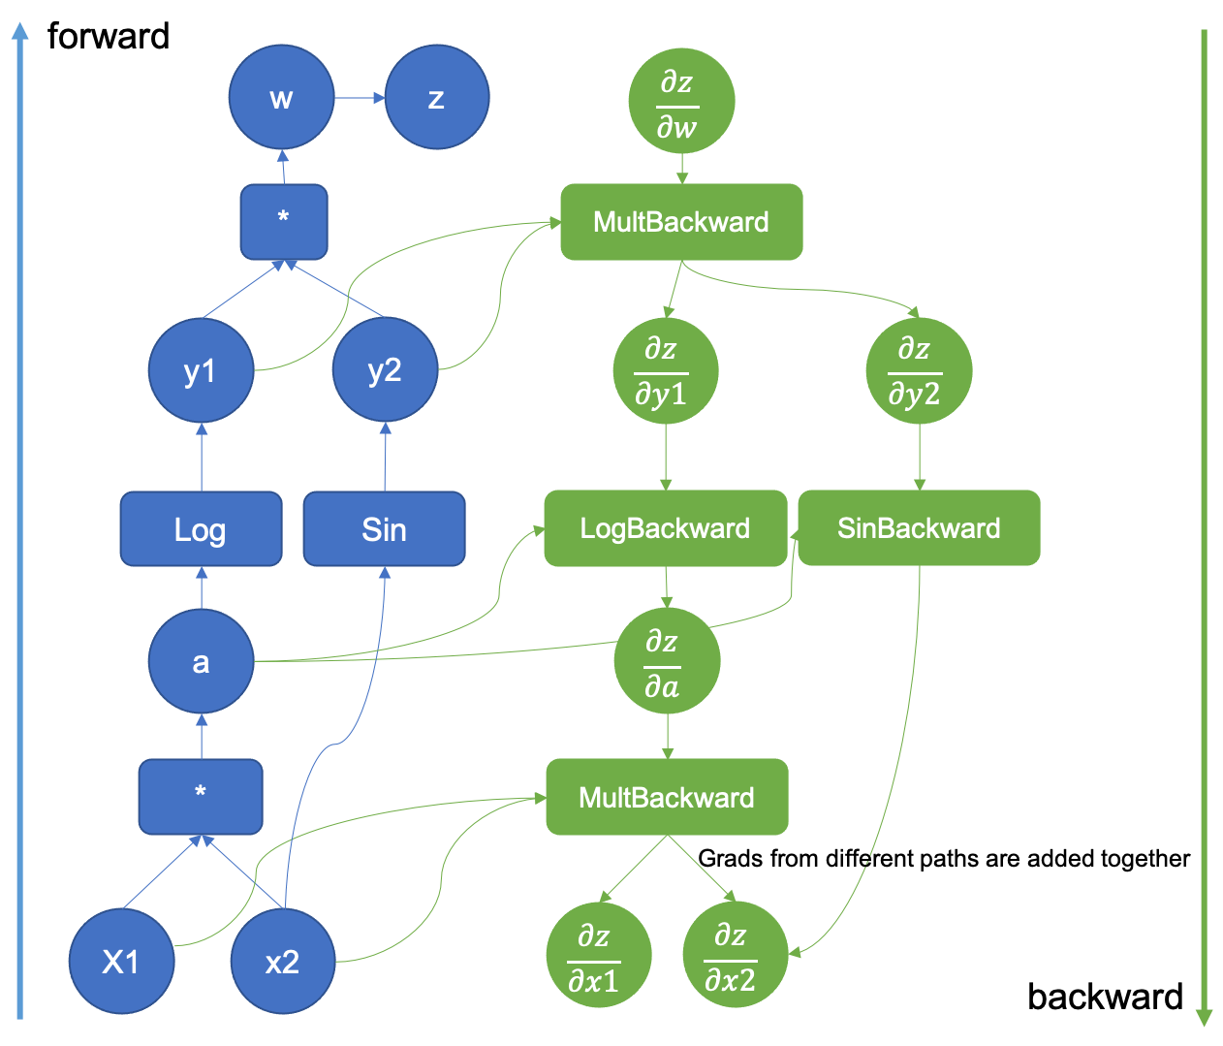

computational
graph
(to take derivatives of deep nets)

Slide 163

Yeah that's pretty much right --Mark
Is this an accurate quote?
--Jim
Yeah, sure
--Mark

Slide 164
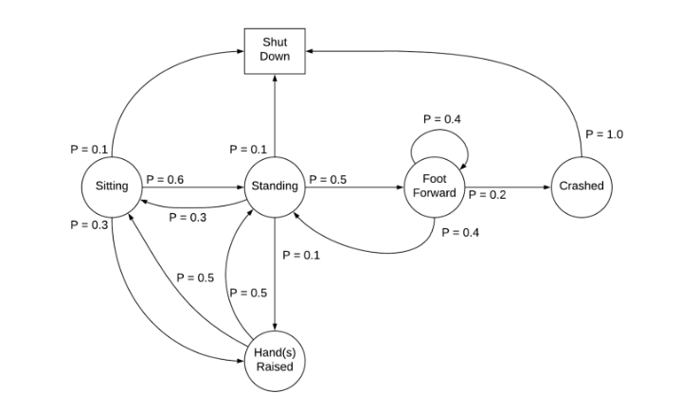
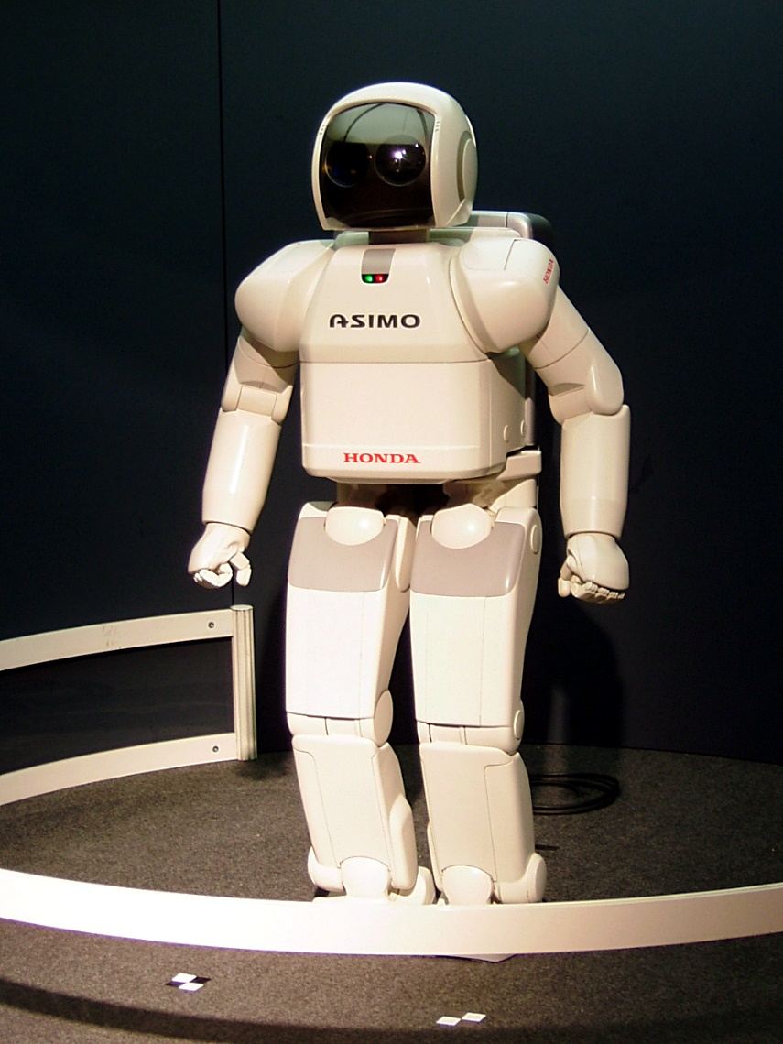
Markov Decision Process

Slide 165
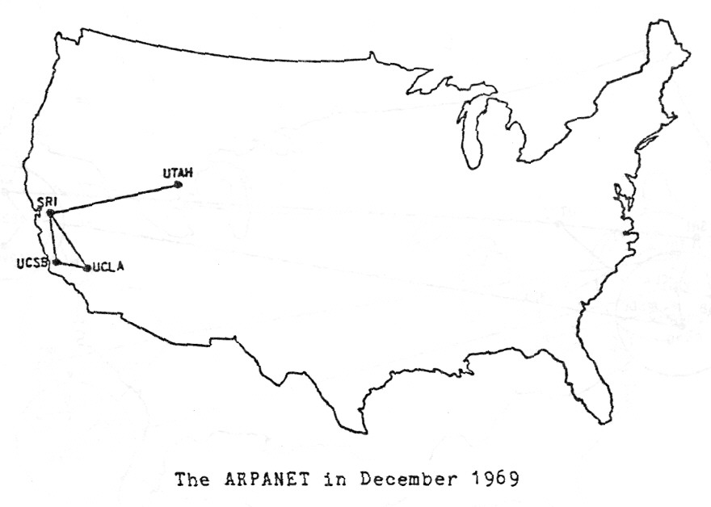

Slide 166

Present day, from Opte The Internet: 1997 - 2021. VIDEO: BARRETT LYON/THE OPTE PROJECT

Slide 167
directed graph representations (how do i store The Data?)

Slide 168
0
1
3
2

Slide 169
Object-Oriented list of nodes
class Graph {
ArrayList<Node> nodes;
Graph() { ... }
}
class Node {
ArrayList<Node> neighbors;
Node() { ... }
}
Graph graph = new Graph();
graph.nodes.add(new Node());
graph.nodes.add(new Node());
graph.nodes.add(new Node());
graph.nodes.add(new Node());
graph.nodes.get(1).neighbors.add(graph.nodes.get(0));
graph.nodes.get(1).neighbors.add(graph.nodes.get(3));
graph.nodes.get(2).neighbors.add(graph.nodes.get(3));
graph.nodes.get(3).neighbors.add(graph.nodes.get(0));
0
1
3
2

Slide 170
Object-Oriented list of nodes
class Graph {
ArrayList<Node> nodes;
Graph() { ... }
}
class Node {
ArrayList<Node> neighbors;
Node() { ... }
}
Graph graph = new Graph();
graph.addNode();
graph.addNode();
graph.addNode();
graph.addNode();
graph.addEdge(1, 0);
graph.addEdge(1, 3);
graph.addEdge(2, 3);
graph.addEdge(3, 0);
0
1
3
2

Slide 171
list of lists
ArrayList<ArrayList<Integer>> graph = new ArrayList<>();
graph.add(new ArrayList<>());
graph.add(new ArrayList<>());
graph.add(new ArrayList<>());
graph.add(new ArrayList<>());
graph.get(1).add(0);
graph.get(1).add(3);
graph.get(2).add(3);
graph.get(3).add(0);
0
1
3
2

Slide 172
list of edges
class Edge {
int i;
int j;
Edge(int i, int j) { ... }
}
int numNodes = 4;
ArrayList<Edge> graph = new ArrayList<>();
graph.add(new Edge(1, 0));
graph.add(new Edge(1, 3));
graph.add(new Edge(2, 3));
graph.add(new Edge(3, 0));
0
1
3
2

Slide 173
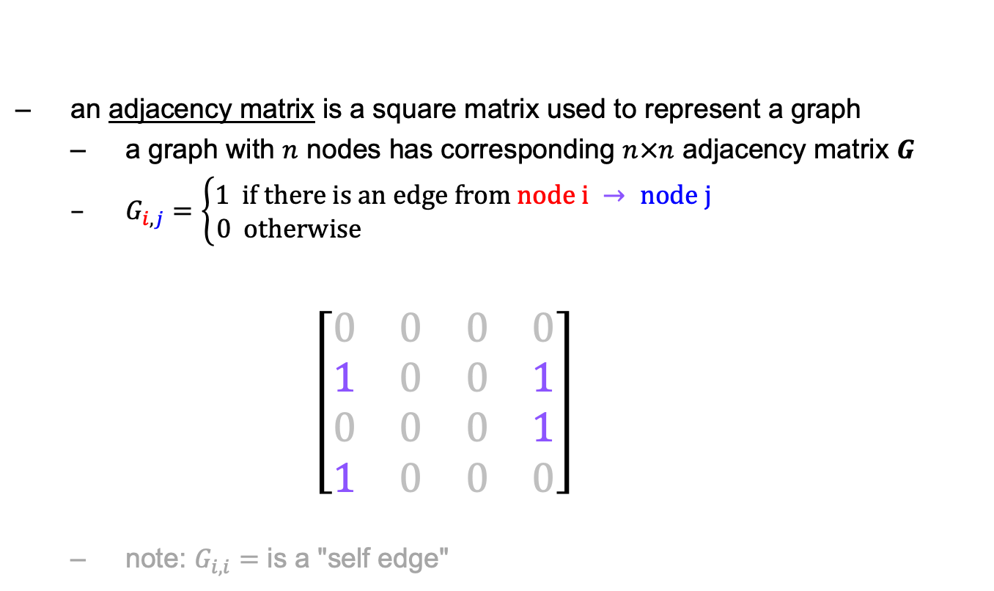
math: adjacency matrix
an adjacency matrix is a square matrix used to represent a graph
a graph with $n$ nodes has corresponding $n×n$ adjacency matrix $G$
$G_{i,j}=\left\{\begin{aligned}1 if there is an edge from node i → node j \\ 0 otherwise \end{aligned}\right.$ $\left[\begin{matrix}0 & 0 & 0 & 0 \\ 1 & 0 & 0 & 1 \\ 0 & 0 & 0 & 1 \\ 1 & 0 & 0 & 0\end{matrix}\right]$
note: $G_{i,i}=$ is a "self edge"
$$\begin{matrix}0 & 1 & 2 & 3\end{matrix}$$
0
1
$$\begin{matrix}0 \\ 1 \\ 2 \\ 3\end{matrix}$$
3
2

Slide 174
dense matrix at 2D array
int[][] graph = new int[4][4];
graph[1][0] = 1;
graph[1][3] = 1;
graph[2][3] = 1;
graph[3][0] = 1;
$$\begin{matrix}0 & 1 & 2 & 3\end{matrix}$$
0
1
$$\begin{matrix}0 \\ 1 \\ 2 \\ 3\end{matrix}$$
$$\left[\begin{matrix}0 & 0 & 0 & 0 \\ 1 & 0 & 0 & 1 \\ 0 & 0 & 0 & 1 \\ 1 & 0 & 0 & 0\end{matrix}\right]$$
3
2

Slide 175
dense matrix as 1D array
int[] graph = new int[4 * 4];
graph[4 * 1 + 0] = 1;
graph[4 * 1 + 3] = 1;
graph[4 * 2 + 3] = 1;
graph[4 * 3 + 0] = 1;
$$\begin{matrix}0 & 1 & 2 & 3\end{matrix}$$
0
1
$$\begin{matrix}0 \\ 1 \\ 2 \\ 3\end{matrix}$$
$$\left[\begin{matrix}0 & 0 & 0 & 0 \\ 1 & 0 & 0 & 1 \\ 0 & 0 & 0 & 1 \\ 1 & 0 & 0 & 0\end{matrix}\right]$$
3
2
$$\left[\begin{matrix}0 & 0 & 0 & 0 & 1 & 0 & 0 & 1 & 0 & 0 & 0 & 1 & 1 & 0 & 0 & 0\end{matrix}\right]$$
$$\begin{matrix}(0, 0) & (0, 1) & (0, 2) & (0, 3) & (1, 0) & (1, 1) & (1, 2) & (1, 3) & (2, 0) & (2, 1) & (2, 2) & (2, 3) & (3, 0) & (3, 1) & (3, 2) & (3, 3)\end{matrix}$$

Slide 176
sparse matrix
class Entry {
int row;
int col;
int val;
Entry(...) { ... }
}
ArrayList<Entry> graph = new ArrayList<>();
graph.add(new Entry(1, 0, 1));
graph.add(new Entry(1, 3, 1));
graph.add(new Entry(2, 3, 1));
graph.add(new Entry(3, 0, 1));
$$\begin{matrix}0 & 1 & 2 & 3\end{matrix}$$
0
1
$$\begin{matrix}0 \\ 1 \\ 2 \\ 3\end{matrix}$$
$$\left[\begin{matrix}0 & 0 & 0 & 0 \\ 1 & 0 & 0 & 1 \\ 0 & 0 & 0 & 1 \\ 1 & 0 & 0 & 0\end{matrix}\right]$$
3
2

Slide 177
Week11a
WARMUP
What does this print?
PRINT(0.1 + 0.2);
PRINT(SQRT(2.0) * SQRT(2.0));
the Fibonacci sequence
recursion
dynamic programming
🦜🦜🦜🦜🦜🦜🦜🦜🦜🦜🦜
🍉
WARMUP
What is F₇?
F₀ = 0
F₁ = 1
F_{k} = F_{k - 1} + F_{k - 2}

Slide 178
what are these?
🍉

Slide 179

the

Slide 180
👼

Slide 181
the Fibonacci sequence

Slide 182


Slide 183
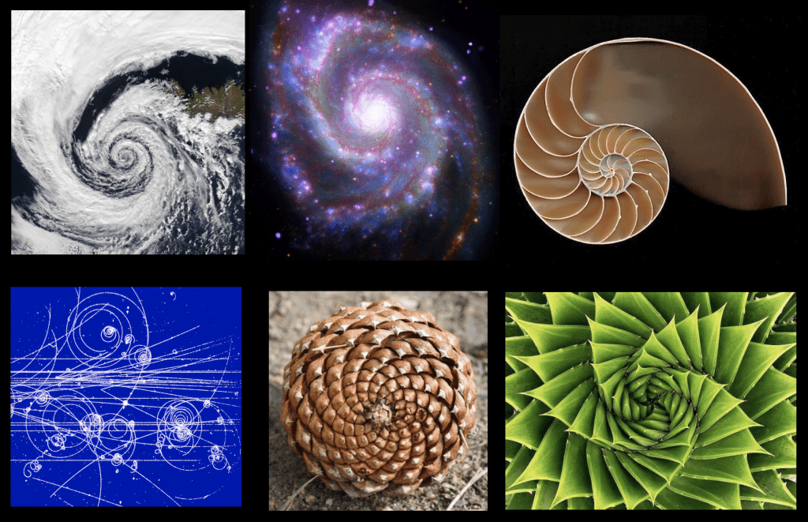

Slide 184
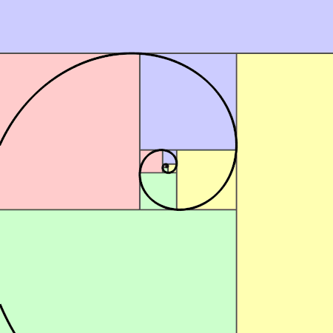

Slide 185
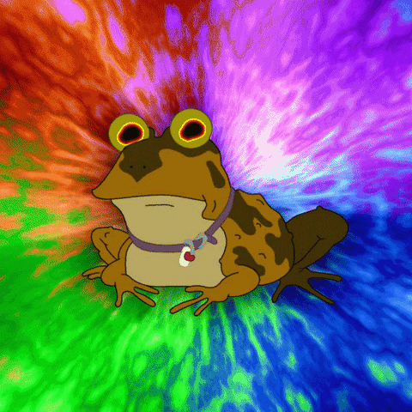

Slide 186
// F_0 = 0
// F_1 = 1
// F_2 = F_1 + F_0 = 1 + 0 = 1
// F_3 = F_2 + F_1 = 1 + 1 = 2
// F_4 = F_3 + F_2 = 2 + 1 = 3
// F_5 = F_4 + F_3 = 3 + 2 = 5
// F_6 = F_5 + F_4 = 5 + 3 = 8
// F_7 = F_6 + F_5 = 8 + 5 = 13
// ...

Slide 187
recursion

Slide 188
review: recursion basics

Slide 189
recursion
a recursive function is a function that calls itself
each call must make progress towards a base case (when the function finally returns without calling itself)
✨ when in doubt, try something like zero for your base case
class Main {
static int digitSum(int n) {
if (n == 0) {
return 0;
}
return digitSum(n / 10) + (n % 10);
}
public static void main(String[] arguments) {
PRINT(digitSum(256)); // 13
}
}

Slide 190
static int digitSum(int n) {
if (n == 0) {
return 0;
}
return digitSum(n / 10) + (n % 10);
}
return 0;
return digitSum(0) + 2;
return digitSum(2) + 5;
return digitSum(25) + 6;
int a = digitSum(256);

Slide 191
static int digitSum(int n) {
if (n == 0) {
return 0;
}
return digitSum(n / 10) + (n % 10);
}
return 0;
return digitSum(0) + 2;
return digitSum(2) + 5;
return digitSum(25) + 6;
int a = digitSum(256);

Slide 192
static int digitSum(int n) {
if (n == 0) {
return 0;
}
return digitSum(n / 10) + (n % 10);
}
return 0 + 2;
return digitSum(2) + 5;
return digitSum(25) + 6;
int a = digitSum(256);

Slide 193
static int digitSum(int n) {
if (n == 0) {
return 0;
}
return digitSum(n / 10) + (n % 10);
}
return 2;
return digitSum(2) + 5;
return digitSum(25) + 6;
int a = digitSum(256);

Slide 194
static int digitSum(int n) {
if (n == 0) {
return 0;
}
return digitSum(n / 10) + (n % 10);
}
return 2;
return digitSum(2) + 5;
return digitSum(25) + 6;
int a = digitSum(256);

Slide 195
static int digitSum(int n) {
if (n == 0) {
return 0;
}
return digitSum(n / 10) + (n % 10);
}
return 2 + 5;
return digitSum(25) + 6;
int a = digitSum(256);

Slide 196
static int digitSum(int n) {
if (n == 0) {
return 0;
}
return digitSum(n / 10) + (n % 10);
}
return 7;
return digitSum(25) + 6;
int a = digitSum(256);

Slide 197
static int digitSum(int n) {
if (n == 0) {
return 0;
}
return digitSum(n / 10) + (n % 10);
}
return 7;
return digitSum(25) + 6;
int a = digitSum(256);

Slide 198
static int digitSum(int n) {
if (n == 0) {
return 0;
}
return digitSum(n / 10) + (n % 10);
}
return 7 + 6;
int a = digitSum(256);

Slide 199
static int digitSum(int n) {
if (n == 0) {
return 0;
}
return digitSum(n / 10) + (n % 10);
}
return 13;
int a = digitSum(256);

Slide 200
static int digitSum(int n) {
if (n == 0) {
return 0;
}
return digitSum(n / 10) + (n % 10);
}
return 13;
int a = digitSum(256);

Slide 201
static int digitSum(int n) {
if (n == 0) {
return 0;
}
return digitSum(n / 10) + (n % 10);
}
int a = 13;

Slide 202
fin.

Slide 203
⚠️ recursion hazard 1 repeated computation

Slide 204
🐌 example: slow very slow fibonnaci (couldn't we just use a for loop...?)
// F_0 = 0
// F_1 = 1
// F_2 = F_1 + F_0 = 1 + 0 = 1
// F_3 = F_2 + F_1 = 1 + 1 = 2
// F_4 = F_3 + F_2 = 2 + 1 = 3
// F_5 = F_4 + F_3 = 3 + 2 = 5
// ...
static long fib(long k) {
if (k == 0) { return 0; }
if (k == 1) { return 1; }
return fib(k - 1) + fib(k - 2);
}

Slide 205
fib(4)

Slide 206
(fib(3) + fib(2))

Slide 207
((fib(2) + fib(1)) + (fib(1) + fib(0)))

Slide 208
(((fib(1) + fib(0)) + fib(1)) + (fib(1) + fib(0)))

Slide 209
(((1 + 0) + 1) + (1 + 0))

Slide 210
((1 + 1) + 1)

Slide 211
(2 + 1)

Slide 212
3

Slide 213
fib(4)

Slide 214
fib(4)
fib(3)
fib(2)

Slide 215
fib(4)
fib(3)
fib(2)
fib(2)
fib(1)

Slide 216
fib(4)
fib(3)
fib(2)
fib(2)
fib(1)
fib(1)
fib(0)

Slide 217
fib(4)
fib(3)
fib(2)
fib(2)
fib(1)
1
0

Slide 218
fib(4)
fib(3)
fib(2)
1
fib(1)

Slide 219
fib(4)
fib(3)
fib(2)
1
1

Slide 220
fib(4)
2
fib(2)

Slide 221
fib(4)
2
fib(2)
fib(1)
fib(0)

Slide 222
fib(4)
2
fib(2)
1
0

Slide 223
fib(4)
2
1

Slide 224
3

Slide 225
🙂

Slide 226
☹️

Slide 227
3

Slide 228
fib(4)

Slide 229
fib(4)
fib(3)
fib(2)
fib(2)
fib(1)
fib(1)
fib(0)
😱 what about this picture does NOT spark joy?
fib(1)
fib(0)

Slide 230
fib(4)
fib(3)
fib(2)
fib(2)
fib(1)
fib(1)
fib(0)
fib(1)
fib(0)

Slide 231
we computed fib(2) from scratch two seperate times 😱 we are repeating computation! (what a waste 😞)

Slide 232
and for bigger n... there is (much) more repetition

Slide 233
F₆
F₄
F₅
F₂
F₃
F₃
F₄
F₀
F₁
F₁
F₂
F₁
F₂
F₂
F₃
F₀
F₁
F₀
F₁
F₀
F₁
F₁
F₂
F₀
F₁

Slide 234
F₆
F₄
F₅
F₂
F₃
F₃
F₄
F₀
F₁
F₁
F₂
F₁
F₂
F₂
F₃
F₀
F₁
F₀
F₁
F₀
F₁
F₁
F₂
F₀
F₁
🧠 who's that
big O runtime?

Slide 235
exponential 🙀

Slide 236
[fib(5), fib(36), fib(77) demo]

Slide 237
⚠️ recursion hazard 2 stack overflow

Slide 238
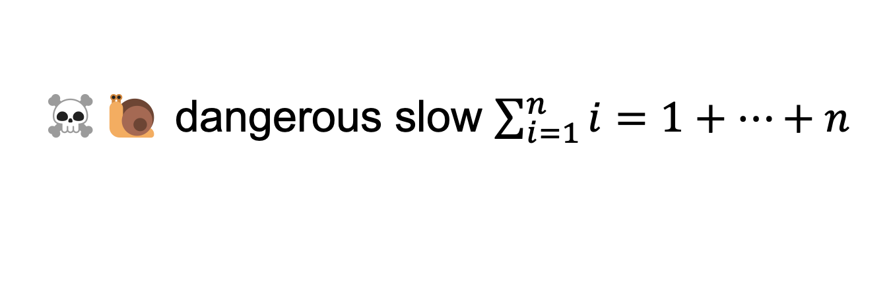
☠️🐌 dangerous slow $\sum_{i=1}^{n}{i}=1+…+n$
// 1 + ... + n
static int sum(int n) {
if (n == 0) return 0;
return n + sum(n - 1);
}

Slide 239
sum(100000)

Slide 240
sum(99999)
sum(100000)

Slide 241
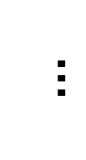
sum(0)
$$…$$
😱 what about this picture does NOT spark joy?
sum(99999)
sum(100000)

Slide 242
the height of the callstack is O(n) 😱 big n → stack overflow! 😞

Slide 243
[sum(100000) demo]

Slide 244
🧠 our depth-first binary (search) tree traversals were recursive... ...should we be worried about them overflowing the callstack?

Slide 245
no. (assuming your tree is ~balanced) callstack height for depth-first balanced binary tree traversal is log(n)
0
1
2
3
4 5
1 1 1 1 1 2 3
0 0 0 0 0 0 0 0 0 0 0
4
5
time

Slide 246
*additionally, some languages/compilers** have "tail-call optimization," which would prevent a stack overflow for sum(100000) **Java is not one of these languages (as our demo showed)

Slide 247
dynamic programming

Slide 248
dynamic programming is when you use the result of previous computation (this is a squishy definition)

Slide 249
F₆
F₄
F₅
F₂
F₃
F₃
F₄
F₀
F₁
F₁
F₂
F₁
F₂
F₂
F₃
F₀
F₁
F₀
F₁
F₀
F₁
F₁
F₂
F₀
F₁

Slide 250
F₆
F₅
F₄
F₄
F₃
F₃
F₂
F₂
F₁
F₁
F₀

Slide 251
F₆
F₅
F₄
F₄
F₃
F₃
F₂
F₂
F₁
F₁
F₀
🧠 who's that
big O runtime?

Slide 252
linear 🙂👍

Slide 253
memoization

Slide 254
memoization means storing the results of previous functions calls, so we don't have to repeat work when the function is called again

Slide 255
🙂 memoized fibonacci
static HashMap<Long, Long> table = new HashMap<>();
static long memoizedFib(long k) { // NOTE: long is an integer type
// that can store larger numbers than int
if (k == 0) { return 0; }
if (k == 1) { return 1; }
long Fkm1;
if (table.containsKey(k - 1)) {
Fkm1 = table.get(k - 1);
} else {
Fkm1 = memoizedFib(k - 1);
table.put(k - 1, Fkm1);
}
long Fkm2;
if (table.containsKey(k - 2)) {
Fkm2 = table.get(k - 2);
} else {
Fkm2 = memoizedFib(k - 2);
table.put(k - 2, Fkm2);
}
return Fkm1 + Fkm2;
}
🧠 what's the runtime of each call to memoizedFib(...)?
public static void main(...) {
int n = ...;
long a = memoizedFib(n);
long b = memoizedFib(n - 1);
long c = memoizedFib(n + 1);
}

Slide 256
int n = ...; long a = memoizedFib(n); // O(n) long b = memoizedFib(n - 1); // O(1) long c = memoizedFib(n + 1); // O(1)

Slide 257
👻 closed form fibonacci

Slide 258
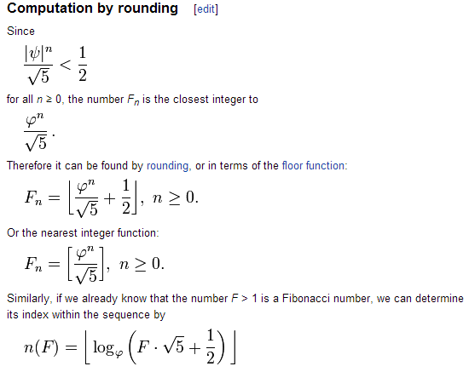

Slide 259
👻 approximate closed-form fibonnaci
// NOTE: Because of floating point error, this does not work for big n.
// (On my computer, returns wrong result for n > 70.)
static long closedFormFib(long n) {
final double goldenRatio = (1.0 + Math.sqrt(5.0)) / 2.0;
return Math.round(Math.pow(goldenRatio, n) / Math.sqrt(5.0));
}

Slide 260
exponentiation by squaring

Slide 261
note: there is actually a log(n) algorithm using matrices and "exponentiation by squaring" this algorithm does NOT have floating point problems (all numbers are integers)

Slide 262
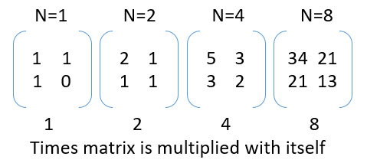

Slide 263
Week11b
WARMUP
Say n = 64
Your goal is to compute 3^n ("3 to the n-th power") using only the multiplication operator (*)
Give an O(n) algorithm
Give an O(log n) algorithm
Fibonacci wrapup
recursion example
🦜🦜🦜🦜🦜🦜🦜🦜🦜🦜🦜

Slide 264
recursive fibonacci wrapup

Slide 265
review: bad bad very bad recursive O(2^n) fibonacci

Slide 266
🐌 recursive O(2^n) fibonacci
static long fib(long k) {
if (k == 0) { return 0; }
if (k == 1) { return 1; }
return fib(k - 1) + fib(k - 2);
}

Slide 267
review: recursive memoized O(n) fibonacci

Slide 268
🙂 memoized recursive O(n) fibonacci
// NOTE: Could also have used an array, with, for example, value 0 meaning "not yet computed."
static HashMap<Integer, Long> table = new HashMap<>();
static long fib(int k) {
if (k == 0) { return 0; }
if (k == 1) { return 1; }
long Fkm1;
if (table.containsKey(k - 1)) {
Fkm1 = table.get(k - 1);
} else {
Fkm1 = fib(k - 1);
table.put(k - 1, Fkm1);
}
long Fkm2;
if (table.containsKey(k - 2)) {
Fkm2 = table.get(k - 2);
} else {
Fkm2 = fib(k - 2);
table.put(k - 2, Fkm2);
}
return Fkm1 + Fkm2;
}

Slide 269
can we get the best of both worlds? (easy to read, fast)

Slide 270
[add a helper function]

Slide 271
🙂 recursive O(n) fibonnaci
static HashMap<Integer, Long> table = new HashMap<>();
static long fibHelper(int k) {
long result;
if (table.containsKey(k)) {
result = table.get(k);
} else {
result = fib(k);
table.put(k, result);
}
return result;
}
static long fib(int k) {
if (k == 0) { return 0; }
if (k == 1) { return 1; }
return fibHelper(k - 1) + fibHelper(k - 2);
}

Slide 272
alternate fibonacci approaches

Slide 273
iterative (not-recursive) O(n) fibonacci

Slide 274
🙂 iterative O(n) fibonnaci
(F₁, F₀) ← = (1, 0)
(F₂, F₁) ← (1 + 0, 1) = (1, 1)
(F₃, F₂) ← (1 + 1, 1) = (2, 1)
(F₄, F₃) ← (2 + 1, 2) = (3, 2)
(F₅, F₄) ← (3 + 2, 3) = (5, 3)
static long fib(int n) {
long F_i = 1;
long F_im1 = 0;
for (int i = 2; i <= n + 1; ++i) {
// (F_i, F_im1) <- (F_i + F_im1, F_i)
long tmp = F_i;
F_i += F_im1;
F_im1 = tmp;
}
return F_im1;
}
TODO make better
def fib(n):
F_i = 1
F_im1 = 0
for i in range(2, n + 2):
F_i, F_im1 = (F_i + F_im1), F_i
return F_im1

Slide 275
closed form fibonacci

Slide 277
👻 approximate closed-form fibonnaci
// NOTE: Because of floating point error, this does not work for big n.
// (On my computer, returns wrong result for n > 70.)
static long closedFormFib(long n) {
final double goldenRatio = (1.0 + Math.sqrt(5.0)) / 2.0;
return Math.round(Math.pow(goldenRatio, n) / Math.sqrt(5.0));
}

Slide 278
O(log n) matrix exponentiation by squaring (oh no) 😀

Slide 279
problem: calculate fib(64) observation: 64 = 2 * 2 * 2 * 2 * 2 * 2

Slide 280
[matrix multiplication review]

Slide 281
[update rule as a matrix multiplication]

Slide 282
[matrix exponentiation by squaring]

Slide 283
recursion example subset sum

Slide 284
problem overview

Slide 285
given a finite set of numbers $\{a,b,c,…\}$, is there any subset that sums to target $T$?

Slide 286
no. --Mark

Slide 287
examples
is there any subset of { 1, 3, 5 } that sums to 4?
yes; { 1, 3 }
is there any subset of { 1, 3, 5 } that sums to 9?
yes; { 1, 3, 5 }
is there any subset of { 1, 3, 5 } that sums to 0?
yes; {}
is there any subset of { 1, 3, 5 } that sums to 7?
no

Slide 288
solution method

Slide 289
given a finite set of numbers $\{a,b,c,…\}$, is there any subset that sums to target $T$?

Slide 290
given a finite set of numbers $\{a,b,c,…\}$, is there any subset that sums to target $T$?

Slide 291
any
for each subset...
if it sums to target...
return true; 🙂
return false;

Slide 292
🧠 why is this maybe not so easy? "hard" means "hard for a computer to solve quickly"
for each subset...
if it sums to target...
return true; 🙂
return false;

Slide 293
what are the subsets of $\{ 1, 2, 3, 4, 5, 6, 7, 8, 9 \}$?

Slide 294
∅ | {1} | {2} | {3} | {4} | {5} | {6} | {7} | {8} | {9} | {1, 2} | {1, 3} | {1, 4} | {1, 5} | {1, 6} | {1, 7} | {1, 8} | {1, 9} | {2, 3} | {2, 4} | {2, 5} | {2, 6} | {2, 7} | {2, 8} | {2, 9} | {3, 4} | {3, 5} | {3, 6} | {3, 7} | {3, 8} | {3, 9} | {4, 5} | {4, 6} | {4, 7} | {4, 8} | {4, 9} | {5, 6} | {5, 7} | {5, 8} | {5, 9} | {6, 7} | {6, 8} | {6, 9} | {7, 8} | {7, 9} | {8, 9} | {1, 2, 3} | {1, 2, 4} | {1, 2, 5} | {1, 2, 6} | {1, 2, 7} | {1, 2, 8} | {1, 2, 9} | {1, 3, 4} | {1, 3, 5} | {1, 3, 6} | {1, 3, 7} | {1, 3, 8} | {1, 3, 9} | {1, 4, 5} | {1, 4, 6} | {1, 4, 7} | {1, 4, 8} | {1, 4, 9} | {1, 5, 6} | {1, 5, 7} | {1, 5, 8} | {1, 5, 9} | {1, 6, 7} | {1, 6, 8} | {1, 6, 9} | {1, 7, 8} | {1, 7, 9} | {1, 8, 9} | {2, 3, 4} | {2, 3, 5} | {2, 3, 6} | {2, 3, 7} | {2, 3, 8} | {2, 3, 9} | {2, 4, 5} | {2, 4, 6} | {2, 4, 7} | {2, 4, 8} | {2, 4, 9} | {2, 5, 6} | {2, 5, 7} | {2, 5, 8} | {2, 5, 9} | {2, 6, 7} | {2, 6, 8} | {2, 6, 9} | {2, 7, 8} | {2, 7, 9} | {2, 8, 9} | {3, 4, 5} | {3, 4, 6} | {3, 4, 7} | {3, 4, 8} | {3, 4, 9} | {3, 5, 6} | {3, 5, 7} | {3, 5, 8} | {3, 5, 9} | {3, 6, 7} | {3, 6, 8} | {3, 6, 9} | {3, 7, 8} | {3, 7, 9} | {3, 8, 9} | {4, 5, 6} | {4, 5, 7} | {4, 5, 8} | {4, 5, 9} | {4, 6, 7} | {4, 6, 8} | {4, 6, 9} | {4, 7, 8} | {4, 7, 9} | {4, 8, 9} | {5, 6, 7} | {5, 6, 8} | {5, 6, 9} | {5, 7, 8} | {5, 7, 9} | {5, 8, 9} | {6, 7, 8} | {6, 7, 9} | {6, 8, 9} | {7, 8, 9} | {1, 2, 3, 4} | {1, 2, 3, 5} | {1, 2, 3, 6} | {1, 2, 3, 7} | {1, 2, 3, 8} | {1, 2, 3, 9} | {1, 2, 4, 5} | {1, 2, 4, 6} | {1, 2, 4, 7} | {1, 2, 4, 8} | {1, 2, 4, 9} | {1, 2, 5, 6} | {1, 2, 5, 7} | {1, 2, 5, 8} | {1, 2, 5, 9} | {1, 2, 6, 7} | {1, 2, 6, 8} | {1, 2, 6, 9} | {1, 2, 7, 8} | {1, 2, 7, 9} | {1, 2, 8, 9} | {1, 3, 4, 5} | {1, 3, 4, 6} | {1, 3, 4, 7} | {1, 3, 4, 8} | {1, 3, 4, 9} | {1, 3, 5, 6} | {1, 3, 5, 7} | {1, 3, 5, 8} | {1, 3, 5, 9} | {1, 3, 6, 7} | {1, 3, 6, 8} | {1, 3, 6, 9} | {1, 3, 7, 8} | {1, 3, 7, 9} | {1, 3, 8, 9} | {1, 4, 5, 6} | {1, 4, 5, 7} | {1, 4, 5, 8} | {1, 4, 5, 9} | {1, 4, 6, 7} | {1, 4, 6, 8} | {1, 4, 6, 9} | {1, 4, 7, 8} | {1, 4, 7, 9} | {1, 4, 8, 9} | {1, 5, 6, 7} | {1, 5, 6, 8} | {1, 5, 6, 9} | {1, 5, 7, 8} | {1, 5, 7, 9} | {1, 5, 8, 9} | {1, 6, 7, 8} | {1, 6, 7, 9} | {1, 6, 8, 9} | {1, 7, 8, 9} | {2, 3, 4, 5} | {2, 3, 4, 6} | {2, 3, 4, 7} | {2, 3, 4, 8} | {2, 3, 4, 9} | {2, 3, 5, 6} | {2, 3, 5, 7} | {2, 3, 5, 8} | {2, 3, 5, 9} | {2, 3, 6, 7} | {2, 3, 6, 8} | {2, 3, 6, 9} | {2, 3, 7, 8} | {2, 3, 7, 9} | {2, 3, 8, 9} | {2, 4, 5, 6} | {2, 4, 5, 7} | {2, 4, 5, 8} | {2, 4, 5, 9} | {2, 4, 6, 7} | {2, 4, 6, 8} | {2, 4, 6, 9} | {2, 4, 7, 8} | {2, 4, 7, 9} | {2, 4, 8, 9} | {2, 5, 6, 7} | {2, 5, 6, 8} | {2, 5, 6, 9} | {2, 5, 7, 8} | {2, 5, 7, 9} | {2, 5, 8, 9} | {2, 6, 7, 8} | {2, 6, 7, 9} | {2, 6, 8, 9} | {2, 7, 8, 9} | {3, 4, 5, 6} | {3, 4, 5, 7} | {3, 4, 5, 8} | {3, 4, 5, 9} | {3, 4, 6, 7} | {3, 4, 6, 8} | {3, 4, 6, 9} | {3, 4, 7, 8} | {3, 4, 7, 9} | {3, 4, 8, 9} | {3, 5, 6, 7} | {3, 5, 6, 8} | {3, 5, 6, 9} | {3, 5, 7, 8} | {3, 5, 7, 9} | {3, 5, 8, 9} | {3, 6, 7, 8} | {3, 6, 7, 9} | {3, 6, 8, 9} | {3, 7, 8, 9} | {4, 5, 6, 7} | {4, 5, 6, 8} | {4, 5, 6, 9} | {4, 5, 7, 8} | {4, 5, 7, 9} | {4, 5, 8, 9} | {4, 6, 7, 8} | {4, 6, 7, 9} | {4, 6, 8, 9} | {4, 7, 8, 9} | {5, 6, 7, 8} | {5, 6, 7, 9} | {5, 6, 8, 9} | {5, 7, 8, 9} | {6, 7, 8, 9} | {1, 2, 3, 4, 5} | {1, 2, 3, 4, 6} | {1, 2, 3, 4, 7} | {1, 2, 3, 4, 8} | {1, 2, 3, 4, 9} | {1, 2, 3, 5, 6} | {1, 2, 3, 5, 7} | {1, 2, 3, 5, 8} | {1, 2, 3, 5, 9} | {1, 2, 3, 6, 7} | {1, 2, 3, 6, 8} | {1, 2, 3, 6, 9} | {1, 2, 3, 7, 8} | {1, 2, 3, 7, 9} | {1, 2, 3, 8, 9} | {1, 2, 4, 5, 6} | {1, 2, 4, 5, 7} | {1, 2, 4, 5, 8} | {1, 2, 4, 5, 9} | {1, 2, 4, 6, 7} | {1, 2, 4, 6, 8} | {1, 2, 4, 6, 9} | {1, 2, 4, 7, 8} | {1, 2, 4, 7, 9} | {1, 2, 4, 8, 9} | {1, 2, 5, 6, 7} | {1, 2, 5, 6, 8} | {1, 2, 5, 6, 9} | {1, 2, 5, 7, 8} | {1, 2, 5, 7, 9} | {1, 2, 5, 8, 9} | {1, 2, 6, 7, 8} | {1, 2, 6, 7, 9} | {1, 2, 6, 8, 9} | {1, 2, 7, 8, 9} | {1, 3, 4, 5, 6} | {1, 3, 4, 5, 7} | {1, 3, 4, 5, 8} | {1, 3, 4, 5, 9} | {1, 3, 4, 6, 7} | {1, 3, 4, 6, 8} | {1, 3, 4, 6, 9} | {1, 3, 4, 7, 8} | {1, 3, 4, 7, 9} | {1, 3, 4, 8, 9} | {1, 3, 5, 6, 7} | {1, 3, 5, 6, 8} | {1, 3, 5, 6, 9} | {1, 3, 5, 7, 8} | {1, 3, 5, 7, 9} | {1, 3, 5, 8, 9} | {1, 3, 6, 7, 8} | {1, 3, 6, 7, 9} | {1, 3, 6, 8, 9} | {1, 3, 7, 8, 9} | {1, 4, 5, 6, 7} | {1, 4, 5, 6, 8} | {1, 4, 5, 6, 9} | {1, 4, 5, 7, 8} | {1, 4, 5, 7, 9} | {1, 4, 5, 8, 9} | {1, 4, 6, 7, 8} | {1, 4, 6, 7, 9} | {1, 4, 6, 8, 9} | {1, 4, 7, 8, 9} | {1, 5, 6, 7, 8} | {1, 5, 6, 7, 9} | {1, 5, 6, 8, 9} | {1, 5, 7, 8, 9} | {1, 6, 7, 8, 9} | {2, 3, 4, 5, 6} | {2, 3, 4, 5, 7} | {2, 3, 4, 5, 8} | {2, 3, 4, 5, 9} | {2, 3, 4, 6, 7} | {2, 3, 4, 6, 8} | {2, 3, 4, 6, 9} | {2, 3, 4, 7, 8} | {2, 3, 4, 7, 9} | {2, 3, 4, 8, 9} | {2, 3, 5, 6, 7} | {2, 3, 5, 6, 8} | {2, 3, 5, 6, 9} | {2, 3, 5, 7, 8} | {2, 3, 5, 7, 9} | {2, 3, 5, 8, 9} | {2, 3, 6, 7, 8} | {2, 3, 6, 7, 9} | {2, 3, 6, 8, 9} | {2, 3, 7, 8, 9} | {2, 4, 5, 6, 7} | {2, 4, 5, 6, 8} | {2, 4, 5, 6, 9} | {2, 4, 5, 7, 8} | {2, 4, 5, 7, 9} | {2, 4, 5, 8, 9} | {2, 4, 6, 7, 8} | {2, 4, 6, 7, 9} | {2, 4, 6, 8, 9} | {2, 4, 7, 8, 9} | {2, 5, 6, 7, 8} | {2, 5, 6, 7, 9} | {2, 5, 6, 8, 9} | {2, 5, 7, 8, 9} | {2, 6, 7, 8, 9} | {3, 4, 5, 6, 7} | {3, 4, 5, 6, 8} | {3, 4, 5, 6, 9} | {3, 4, 5, 7, 8} | {3, 4, 5, 7, 9} | {3, 4, 5, 8, 9} | {3, 4, 6, 7, 8} | {3, 4, 6, 7, 9} | {3, 4, 6, 8, 9} | {3, 4, 7, 8, 9} | {3, 5, 6, 7, 8} | {3, 5, 6, 7, 9} | {3, 5, 6, 8, 9} | {3, 5, 7, 8, 9} | {3, 6, 7, 8, 9} | {4, 5, 6, 7, 8} | {4, 5, 6, 7, 9} | {4, 5, 6, 8, 9} | {4, 5, 7, 8, 9} | {4, 6, 7, 8, 9} | {5, 6, 7, 8, 9} | {1, 2, 3, 4, 5, 6} | {1, 2, 3, 4, 5, 7} | {1, 2, 3, 4, 5, 8} | {1, 2, 3, 4, 5, 9} | {1, 2, 3, 4, 6, 7} | {1, 2, 3, 4, 6, 8} | {1, 2, 3, 4, 6, 9} | {1, 2, 3, 4, 7, 8} | {1, 2, 3, 4, 7, 9} | {1, 2, 3, 4, 8, 9} | {1, 2, 3, 5, 6, 7} | {1, 2, 3, 5, 6, 8} | {1, 2, 3, 5, 6, 9} | {1, 2, 3, 5, 7, 8} | {1, 2, 3, 5, 7, 9} | {1, 2, 3, 5, 8, 9} | {1, 2, 3, 6, 7, 8} | {1, 2, 3, 6, 7, 9} | {1, 2, 3, 6, 8, 9} | {1, 2, 3, 7, 8, 9} | {1, 2, 4, 5, 6, 7} | {1, 2, 4, 5, 6, 8} | {1, 2, 4, 5, 6, 9} | {1, 2, 4, 5, 7, 8} | {1, 2, 4, 5, 7, 9} | {1, 2, 4, 5, 8, 9} | {1, 2, 4, 6, 7, 8} | {1, 2, 4, 6, 7, 9} | {1, 2, 4, 6, 8, 9} | {1, 2, 4, 7, 8, 9} | {1, 2, 5, 6, 7, 8} | {1, 2, 5, 6, 7, 9} | {1, 2, 5, 6, 8, 9} | {1, 2, 5, 7, 8, 9} | {1, 2, 6, 7, 8, 9} | {1, 3, 4, 5, 6, 7} | {1, 3, 4, 5, 6, 8} | {1, 3, 4, 5, 6, 9} | {1, 3, 4, 5, 7, 8} | {1, 3, 4, 5, 7, 9} | {1, 3, 4, 5, 8, 9} | {1, 3, 4, 6, 7, 8} | {1, 3, 4, 6, 7, 9} | {1, 3, 4, 6, 8, 9} | {1, 3, 4, 7, 8, 9} | {1, 3, 5, 6, 7, 8} | {1, 3, 5, 6, 7, 9} | {1, 3, 5, 6, 8, 9} | {1, 3, 5, 7, 8, 9} | {1, 3, 6, 7, 8, 9} | {1, 4, 5, 6, 7, 8} | {1, 4, 5, 6, 7, 9} | {1, 4, 5, 6, 8, 9} | {1, 4, 5, 7, 8, 9} | {1, 4, 6, 7, 8, 9} | {1, 5, 6, 7, 8, 9} | {2, 3, 4, 5, 6, 7} | {2, 3, 4, 5, 6, 8} | {2, 3, 4, 5, 6, 9} | {2, 3, 4, 5, 7, 8} | {2, 3, 4, 5, 7, 9} | {2, 3, 4, 5, 8, 9} | {2, 3, 4, 6, 7, 8} | {2, 3, 4, 6, 7, 9} | {2, 3, 4, 6, 8, 9} | {2, 3, 4, 7, 8, 9} | {2, 3, 5, 6, 7, 8} | {2, 3, 5, 6, 7, 9} | {2, 3, 5, 6, 8, 9} | {2, 3, 5, 7, 8, 9} | {2, 3, 6, 7, 8, 9} | {2, 4, 5, 6, 7, 8} | {2, 4, 5, 6, 7, 9} | {2, 4, 5, 6, 8, 9} | {2, 4, 5, 7, 8, 9} | {2, 4, 6, 7, 8, 9} | {2, 5, 6, 7, 8, 9} | {3, 4, 5, 6, 7, 8} | {3, 4, 5, 6, 7, 9} | {3, 4, 5, 6, 8, 9} | {3, 4, 5, 7, 8, 9} | {3, 4, 6, 7, 8, 9} | {3, 5, 6, 7, 8, 9} | {4, 5, 6, 7, 8, 9} | {1, 2, 3, 4, 5, 6, 7} | {1, 2, 3, 4, 5, 6, 8} | {1, 2, 3, 4, 5, 6, 9} | {1, 2, 3, 4, 5, 7, 8} | {1, 2, 3, 4, 5, 7, 9} | {1, 2, 3, 4, 5, 8, 9} | {1, 2, 3, 4, 6, 7, 8} | {1, 2, 3, 4, 6, 7, 9} | {1, 2, 3, 4, 6, 8, 9} | {1, 2, 3, 4, 7, 8, 9} | {1, 2, 3, 5, 6, 7, 8} | {1, 2, 3, 5, 6, 7, 9} | {1, 2, 3, 5, 6, 8, 9} | {1, 2, 3, 5, 7, 8, 9} | {1, 2, 3, 6, 7, 8, 9} | {1, 2, 4, 5, 6, 7, 8} | {1, 2, 4, 5, 6, 7, 9} | {1, 2, 4, 5, 6, 8, 9} | {1, 2, 4, 5, 7, 8, 9} | {1, 2, 4, 6, 7, 8, 9} | {1, 2, 5, 6, 7, 8, 9} | {1, 3, 4, 5, 6, 7, 8} | {1, 3, 4, 5, 6, 7, 9} | {1, 3, 4, 5, 6, 8, 9} | {1, 3, 4, 5, 7, 8, 9} | {1, 3, 4, 6, 7, 8, 9} | {1, 3, 5, 6, 7, 8, 9} | {1, 4, 5, 6, 7, 8, 9} | {2, 3, 4, 5, 6, 7, 8} | {2, 3, 4, 5, 6, 7, 9} | {2, 3, 4, 5, 6, 8, 9} | {2, 3, 4, 5, 7, 8, 9} | {2, 3, 4, 6, 7, 8, 9} | {2, 3, 5, 6, 7, 8, 9} | {2, 4, 5, 6, 7, 8, 9} | {3, 4, 5, 6, 7, 8, 9} | {1, 2, 3, 4, 5, 6, 7, 8} | {1, 2, 3, 4, 5, 6, 7, 9} | {1, 2, 3, 4, 5, 6, 8, 9} | {1, 2, 3, 4, 5, 7, 8, 9} | {1, 2, 3, 4, 6, 7, 8, 9} | {1, 2, 3, 5, 6, 7, 8, 9} | {1, 2, 4, 5, 6, 7, 8, 9} | {1, 3, 4, 5, 6, 7, 8, 9} | {2, 3, 4, 5, 6, 7, 8, 9} | {1, 2, 3, 4, 5, 6, 7, 8, 9}

Slide 295
there are $2^{9}$ of them

Slide 296
🧠 why?

Slide 297
each of the 9 elements is either included or not included (excluded) in the subset 9 include/exclude decisions => 2⁹

Slide 298
enumerate

Slide 299
what are the subsets of $\{3, 4, 5\}$?

Slide 300
what are the subsets of $\{3, 4, 5\}$?
all possible subsets
include 5?
$$\{\}$$
$$\{5\}$$
$$\{4\}$$
$$\{4,5\}$$
$$\{3\}$$
$$\{3,5\}$$
$$\{3,4\}$$
$$\{3,4,5\}$$
include 4?
$$\{\}$$
$$\{4\}$$
$$\{3\}$$
$$\{3,4\}$$
no
yes
no
yes
include 3?
$$\{\}$$
$$\{3\}$$
no
yes
$$\{\}$$

Slide 301
hint

Slide 302
Question: “can any subset of $\left\{a,b,c,…\right\}$ sum to $T$?” key insight Considering just $a$, we have two cases: 1) exclude $a$ in this case, Equivalent Question: “can any subset of $\{b,c,…\}$ sum to $T$?” 2) include $a$ in this case, Equivalent Question: “can any subset of $\{b,c,…\}$ sum to $T−a$?”

Slide 303
does any subset of {} sum to 0?
include 2nd
element?
$$\{\}$$
$$\{5\}$$
$$\{4\}$$
$$\{4,5\}$$
$$\{3\}$$
$$\{3,5\}$$
$$\{3,4\}$$
$$\{3,4,5\}$$
$$\{\}$$
$$\{4\}$$
$$\{3\}$$
$$\{3,4\}$$
include 1st
element?
$$\{\}$$
does any subset of $\left\{5\right\}$ sum to 5?
$$\{3\}$$
include 0th
element?
does any subset of $\left\{4,5\right\}$ sum to 5?
$$\{\}$$
does any subset of $\left\{3,4,5\right\}$ sum to 8?

Slide 304
okay cool good luck

Slide 305

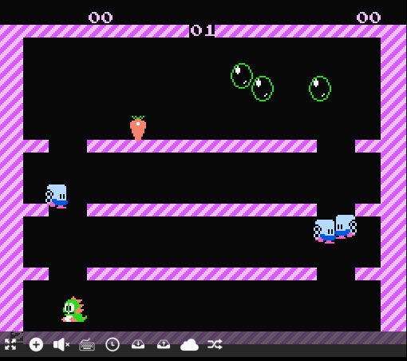
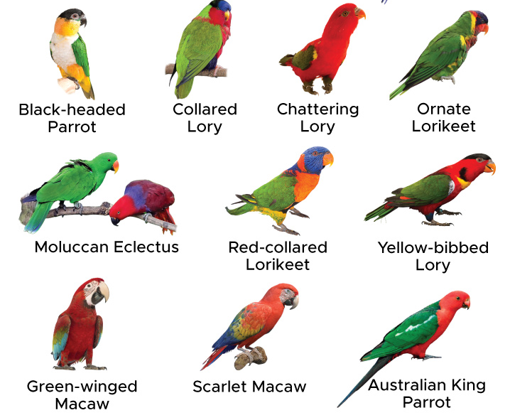
Week11c
Final Project
WARMUP: What part of this game would you implement... first? last?

Slide 306
final project

Slide 307
final project

Slide 308
You may do your final project on whatever you like, provided you can answer the following questions.
What is the title of my project?
What data structures will I use? Note: Arrays count.
What is the game/app that I am proposing? What does it do? How does it feel?
Will the viewer/player interact with my project? How so?
Does Jim think my project is doable? What is my fallback plan if my project ends up being harder than I expect? What extensions can I do if my project ends up being easier than I expect?
What is the very first thing I will implement? (Drawing "the data" is usually a good first step.)

Slide 309
You may do your final project on whatever you like, provided you can answer the following questions.
What is the title of my project?
What data structures will I use? Note: Arrays count.
What is the game/app that I am proposing? What does it do? How does it feel?
Will the viewer/player interact with my project? How so?
Does Jim think my project is doable? What is my fallback plan if my project ends up being harder than I expect? What extensions can I do if my project ends up being easier than I expect?
What is the very first thing I will implement? (Drawing "the data" is usually a good first step.)

Slide 310
example
Woo!-doku
2D array to represent the board.
A colorful sudoku board, that does a happy dance when you solve it.
Click to select cells. Type numbers on the keyboard to fill in numbers.
Yes! And you can write a sudoku solver or automatic board generation if you have extra time!
Store a board I found on the internet as a 2D array (0's for empty cells) and draw it to the Terminal using print statements (or...just skip straight to Cow)

Slide 311
how are we feeling?

Slide 312
why am i making you make a thing

Slide 313
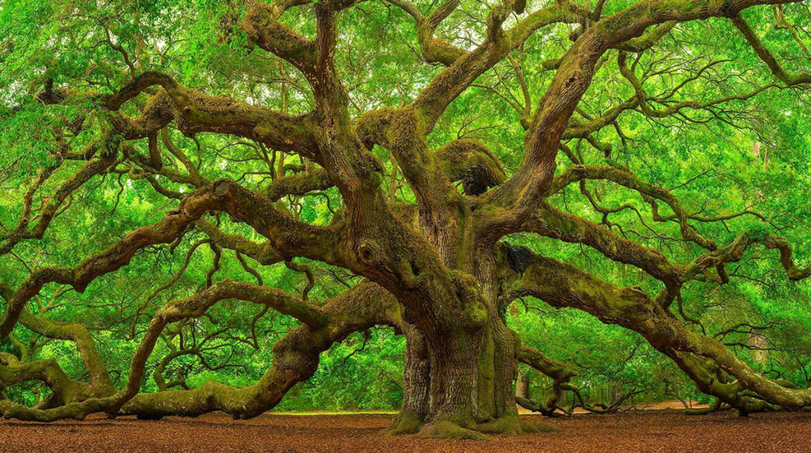

The only way you’re going to grow is by pushing yourself beyond what you think is possible. --David Goggins

Slide 314
how not to make a thing

Slide 315
how not to make a thing

Slide 316
note: this advice is like...just advice feel free to ignore (at your own peril) 🙂

Slide 317
project selection

Slide 318

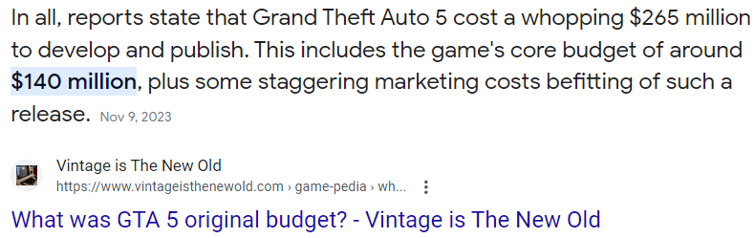
⚠ picking something really, really hard

Slide 319
⚠ picking something with a spooky progress curve
does it work?
deadline
time

Slide 320
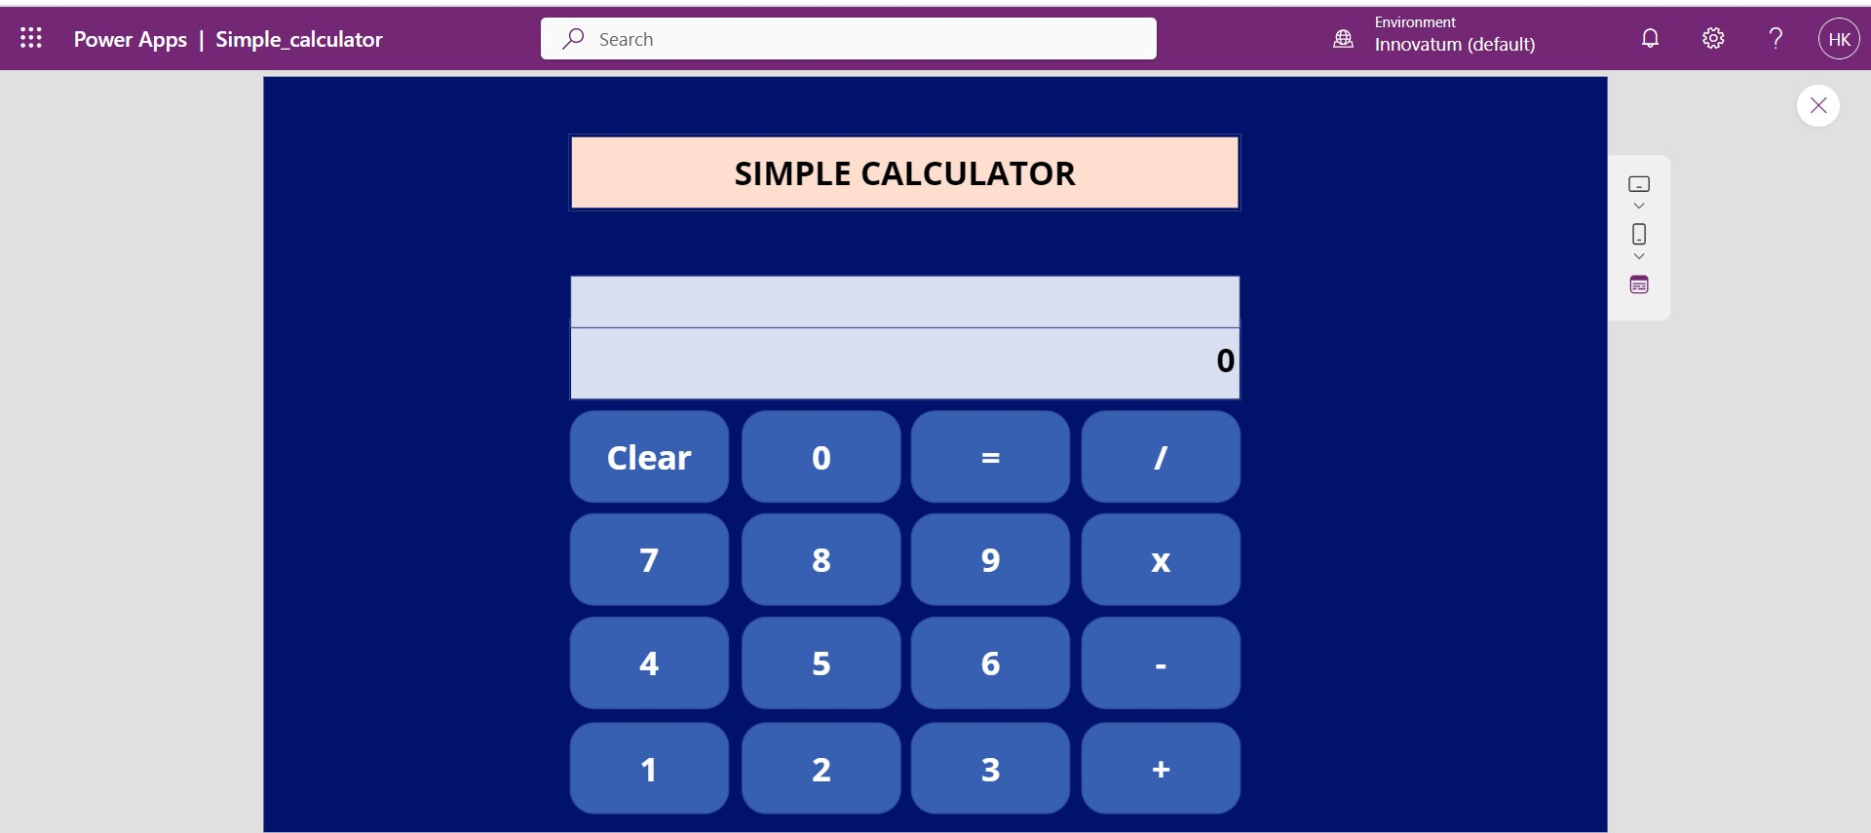
⚠ picking something you aren't really interested in (or can't really be extended)
note: though if you love calculators, go for it!

Slide 321


Slide 323
who (doesn't) have a final project idea? discuss amongst each other

Slide 324
focus (just make sudoku)

Slide 325


⚠ solving a more general problem than you need to
don't support arbitrary board sizes!
just make sudoku!
what?!

Slide 326

⚠ writing more general code than you need to
don't support multiple different kinds of puzzles
just make sudoku!

Slide 327

⚠ doing the fun part first
don't make a fun animated menu screen
just make sudoku!

Slide 328

⚠ skipping development steps
consider making a board print to the terminal
before trying to get it working in Cow.java
consider just filling it with nonsense before filling it with a real board
consider hardcoding a starting board by hand
before implementing automatic board generation

Slide 329

then again, sometimes you just gotta go for it.

Slide 330
who (doesn't) know what they're going to implement first? discuss amongst each other

Slide 331
final thoughts

Slide 332
final thoughts
don't be afraid to write code
don't be afraid to delete code
don't be (too) afraid to fail
you will be graded primarily on effort

Slide 333
how are we feeling?

Slide 334
WARMUP
what is (0.1 + 0.1 + 0.1) ?
imagine you wanted to make this thing →
what would you implement 1st? 2nd?
what would you implement LAST? TODAY
who's to say
Bubble Bobble (NES)

Slide 335
Week10a
✨No Laptop Monday! ✨
binary search
binary search trees
WARMUP
how long does it take to find (search for) something in...
- an array list?
- a linked list?
what if the list is sorted?

Slide 336
[record lecture]

Slide 337
review: sorted

Slide 338
sorted

Slide 339
sorted
a sequence is sorted if its elements are "in order"
by convention, this means ascending order (going up from left to right)
[1, 2, 5, 6, 9, 13] is sorted
[9, 5, 1, 2, 6, 13] is unsorted (NOT sored)

Slide 340
search

Slide 341
search
to search means to look for something (in some data structure)
a simple search problem is finding a given value in an array / list
// get index of the first element in array with this value // returns -1 if value not found int find(int[] array, int value) { ... }
// Option B class FindResult { boolean success; int index; } FindResult find(int[] array, int value) { ... }

Slide 342
linear search (of an array / array list)

Slide 343
linear search (brute force search)
linear search looks at each element one by one
linear search works whether or not the list is sorted
linear search is O(n) (linear time) 😐
// get index of the first element in array with this value // returns -1 if value not found int linearSearch(int[] array, int value) { for (int i = 0; i < array.length; ++i) { if (array[i] == value) { return i; } } return -1; }

Slide 344
example: linear search for 17 [13 2 55 7 17 100 77]

Slide 345
example: linear search for 17 [13 2 55 7 17 100 77]

Slide 346
example: linear search for 17 [13 2 55 7 17 100 77]

Slide 347
example: linear search for 17 [13 2 55 7 17 100 77]

Slide 348
example: linear search for 17 [13 2 55 7 17 100 77]

Slide 349
example: linear search for 17 [13 2 55 7 17 100 77]

Slide 350
example: linear search for 17 [13 2 55 7 17 100 77]

Slide 351
example: linear search for 17 [13 2 55 7 17 100 77]

Slide 352
example: linear search for 17 [13 2 55 7 17 100 77]

Slide 353
example: linear search for 17 [13 2 55 7 17 100 77]

Slide 354
example: linear search for 17 [13 2 55 7 17 100 77]

Slide 356
example: linear search for 17 [1 2 4 5 6 8 9 10 11 13 15 16 17 18 19]

Slide 357
example: linear search for 17 [1 2 4 5 6 8 9 10 11 13 15 16 17 18 19]

Slide 358
example: linear search for 17 [1 2 4 5 6 8 9 10 11 13 15 16 17 18 19]

Slide 359
example: linear search for 17 [1 2 4 5 6 8 9 10 11 13 15 16 17 18 19]

Slide 360
example: linear search for 17 [1 2 4 5 6 8 9 10 11 13 15 16 17 18 19]

Slide 361
example: linear search for 17 [1 2 4 5 6 8 9 10 11 13 15 16 17 18 19]

Slide 362
example: linear search for 17 [1 2 4 5 6 8 9 10 11 13 15 16 17 18 19]

Slide 363
example: linear search for 17 [1 2 4 5 6 8 9 10 11 13 15 16 17 18 19]

Slide 364
example: linear search for 17 [1 2 4 5 6 8 9 10 11 13 15 16 17 18 19]

Slide 365
example: linear search for 17 [1 2 4 5 6 8 9 10 11 13 15 16 17 18 19]

Slide 366
example: linear search for 17 [1 2 4 5 6 8 9 10 11 13 15 16 17 18 19]

Slide 367
example: linear search for 17 [1 2 4 5 6 8 9 10 11 13 15 16 17 18 19]

Slide 368
example: linear search for 17 [1 2 4 5 6 8 9 10 11 13 15 16 17 18 19]

Slide 369
example: linear search for 17 [1 2 4 5 6 8 9 10 11 13 15 16 17 18 19]

Slide 370
example: linear search for 17 [1 2 4 5 6 8 9 10 11 13 15 16 17 18 19]

Slide 371
example: linear search for 17 [1 2 4 5 6 8 9 10 11 13 15 16 17 18 19]

Slide 372
example: linear search for 17 [1 2 4 5 6 8 9 10 11 13 15 16 17 18 19]

Slide 373
example: linear search for 17 [1 2 4 5 6 8 9 10 11 13 15 16 17 18 19]

Slide 374
example: linear search for 17 [1 2 4 5 6 8 9 10 11 13 15 16 17 18 19]

Slide 375
example: linear search for 17 [1 2 4 5 6 8 9 10 11 13 15 16 17 18 19]

Slide 376
example: linear search for 17 [1 2 4 5 6 8 9 10 11 13 15 16 17 18 19]

Slide 377
example: linear search for 17 [1 2 4 5 6 8 9 10 11 13 15 16 17 18 19]

Slide 378
example: linear search for 17 [1 2 4 5 6 8 9 10 11 13 15 16 17 18 19]

Slide 379
example: linear search for 17 [1 2 4 5 6 8 9 10 11 13 15 16 17 18 19]

Slide 380
example: linear search for 17 [1 2 4 5 6 8 9 10 11 13 15 16 17 18 19]

Slide 381
example: linear search for 17 [1 2 4 5 6 8 9 10 11 13 15 16 17 18 19]

Slide 382
example: linear search for 17 [1 2 4 5 6 8 9 10 11 13 15 16 17 18 19]

Slide 383
if we know that an array is sorted... can we search it faster?

Slide 384
yes 🚀

Slide 385
unless it's a linked list 💀

Slide 386
binary search (of a array / array list)

Slide 387
binary search
binary search is an O(log n) algorithm for searching a sorted array 🙂
binary search works by "cutting the array in half" over and over
☠️ binary search only applies if the array is sorted

Slide 388
example: binary search for 17 [1 2 4 5 6 8 9 10 11 13 15 16 17 18 19]

Slide 389
example: binary search for 17 [1 2 4 5 6 8 9 10 11 13 15 16 17 18 19]
10 < 17

Slide 390
example: binary search for 17 [1 2 4 5 6 8 9 10 11 13 15 16 17 18 19]

Slide 391
example: binary search for 17 [1 2 4 5 6 8 9 10 11 13 15 16 17 18 19]
16 < 17

Slide 392
example: binary search for 17 [1 2 4 5 6 8 9 10 11 13 15 16 17 18 19]

Slide 393
example: binary search for 17 [1 2 4 5 6 8 9 10 11 13 15 16 17 18 19]
17 < 18

Slide 394
example: binary search for 17 [1 2 4 5 6 8 9 10 11 13 15 16 17 18 19]

Slide 395
example: binary search for 17 [1 2 4 5 6 8 9 10 11 13 15 16 17 18 19]
17 == 17

Slide 396
example: binary search for 17 [1 2 4 5 6 8 9 10 11 13 15 16 17 18 19]

Slide 397
☠️ implementating binary search is surprisingly tricky! make sure you test thoroughly!

Slide 398
✨ hint: binary search [1 2 4 5 6 8 9 10 11 13 15 16 17 18 19]
[^ 2 4 5 6 8 9 10 11 13 15 16 17 18 ^ ]
[| 2 4 5 6 8 9 10 11 13 15 16 17 18 | ]
[i = 0 4 5 6 8 9 10 11 13 15 16 17 18 j ]

Slide 399
review: binary tree

Slide 400
binary tree

Slide 401
binary tree
a binary tree is a tree in which each node has <= 2 children
10
5
16
2
13
18
1
4
11
15
17

Slide 402
🧠 can a linked list be seen as a binary tree?

Slide 403
technically, yes (assuming no cycles) all nodes have <= 2 children (tail has 0 children, all other nodes have 1 child)

Slide 404
ordered binary tree

Slide 405
(ordered) binary tree
each node has a left child and a right child (either or both children can be null)
10
5
16
node
13
18
11
15
17
node.leftChild
node.rightChild

Slide 406
(ordered) binary tree
each node has a left subtree and a right subtree (and left descendants and right descendants)

Slide 407
binary search tree

Slide 408
binary search tree

Slide 409
binary search tree
in a binary search tree (BST, sorted binary tree) every node follows: "a node's value is greater than the values of all nodes in its left subtree and less than the values of all nodes in its right subtree"
10
5
16
2
13
18
1
4
11
15
17

Slide 410
binary search tree
in a binary search tree (BST, sorted binary tree) every node follows: "a node's value is greater than the values of all nodes in its left subtree and less than the values of all nodes in its right subtree"
10
10 < 16
5
16
5 < 10
2 < 10
10 < 13
2
13
18
10 < 18
1
4
10 < 11
11
15
17
10 < 17
4 < 10
1 < 10
10 < 15

Slide 411
binary search tree
in a binary search tree (BST, sorted binary tree) every node follows: "a node's value is greater than the values of all nodes in its left subtree and less than the values of all nodes in its right subtree"
10
5
16
13 < 16
2
13
18
16 < 18
1
4
11 < 16
11
15
17
16 < 17
15 < 16

Slide 412
binary search tree
in a binary search tree (BST, sorted binary tree) every node follows: "a node's value is greater than the values of all nodes in its left subtree and less than the values of all nodes in its right subtree"
10
5
16
2
13
18
1
4
11
15
17

Slide 413
is it a BST?

Slide 414
2
4
1
3
6
Is It A Binary Search Tree?
4
9
3
5
in a binary search tree (sorted binary tree) every node follows: "a node's value is greater than the values of all nodes in its left subtree and less than the values of all nodes in its right subtree"
2
1
10
5
16
2
8
13
18
1
4
6
9
14
15
17
19

Slide 415
2
4
1
3
6
4
9
3
5
in a binary search tree (sorted binary tree) every node follows: "a node's value is greater than the values of all nodes in its left subtree and less than the values of all nodes in its right subtree"
2
1
10
5
16
2
8
13
18
1
4
6
9
14
15
17
19

Slide 416
binary search (of a binary search tree)

Slide 417
binary search
binary search "cuts a BST in half" over and over
binary search only works when the binary tree is sorted (is a binary search tree)
binary search is O(log n) if the tree is "balanced" 🙂
balanced means each node's children are similar in height (intuitive understanding of this is sufficient; will discuss more on Fri)
10
10
5
16
5
2
8
13
18
2
1
6
9
11
9
1
balanced
NOT balanced

Slide 418
example: binary search for 17 [1 2 4 5 6 8 9 10 11 13 15 16 17 18 19]
10
5
16
2
8
13
18
1
4
6
9
11
15
17
19

Slide 419
example: binary search for 17 [1 2 4 5 6 8 9 10 11 13 15 16 17 18 19]
10
10 < 17
5
16
2
8
13
18
1
4
6
9
11
15
17
19

Slide 420
example: binary search for 17 [1 2 4 5 6 8 9 10 11 13 15 16 17 18 19]
10
5
16
2
8
13
18
1
4
6
9
11
15
17
19

Slide 421
example: binary search for 17 [1 2 4 5 6 8 9 10 11 13 15 16 17 18 19]
10
5
16
16 < 17
2
8
13
18
1
4
6
9
11
15
17
19

Slide 422
example: binary search for 17 [1 2 4 5 6 8 9 10 11 13 15 16 17 18 19]
10
5
16
2
8
13
18
1
4
6
9
11
15
17
19

Slide 423
example: binary search for 17 [1 2 4 5 6 8 9 10 11 13 15 16 17 18 19]
10
5
16
2
8
13
18
17 < 18
1
4
6
9
11
15
17
19

Slide 424
example: binary search for 17 [1 2 4 5 6 8 9 10 11 13 15 16 17 18 19]
10
5
16
2
8
13
18
1
4
6
9
11
15
17
19

Slide 425
example: binary search for 17 [1 2 4 5 6 8 9 10 11 13 15 16 17 18 19]
10
5
16
2
8
13
18
1
4
6
9
11
15
17
19
17 == 17

Slide 426
example: binary search for 17 [1 2 4 5 6 8 9 10 11 13 15 16 17 18 19]
10
5
16
2
8
13
18
1
4
6
9
11
15
17
19

Slide 427
note: a binary search tree is NOT unique let's look at another BST for the same data!

Slide 428
example: binary search for 17 [1 2 4 5 6 8 9 10 11 13 15 16 17 18 19]
2
1
4
5
6
8
9
10
11
13
15
16
17
18
19

Slide 429
example: binary search for 17 [1 2 4 5 6 8 9 10 11 13 15 16 17 18 19]
2
1
4
5
6
8
9
10
11
13
15
16
17
18
19

Slide 430
example: binary search for 17 [1 2 4 5 6 8 9 10 11 13 15 16 17 18 19]
2
1
4
5
6
8
9
10
11
13
15
16
17
18
19

Slide 431
example: binary search for 17 [1 2 4 5 6 8 9 10 11 13 15 16 17 18 19]
2
1
4
5
6
8
9
10
11
13
15
16
17
18
19

Slide 432
example: binary search for 17 [1 2 4 5 6 8 9 10 11 13 15 16 17 18 19]
2
1
4
5
6
8
9
10
11
13
15
16
17
18
19

Slide 433
example: binary search for 17 [1 2 4 5 6 8 9 10 11 13 15 16 17 18 19]
2
1
4
5
6
8
9
10
11
13
15
16
17
18
19

Slide 434
example: binary search for 17 [1 2 4 5 6 8 9 10 11 13 15 16 17 18 19]
2
1
4
5
6
8
9
10
11
13
15
16
17
18
19

Slide 435
example: binary search for 17 [1 2 4 5 6 8 9 10 11 13 15 16 17 18 19]
2
1
4
5
6
8
9
10
11
13
15
16
17
18
19

Slide 436
example: binary search for 17 [1 2 4 5 6 8 9 10 11 13 15 16 17 18 19]
2
1
4
5
6
8
9
10
11
13
15
16
17
18
19

Slide 437
...

Slide 438
life lesson: it is important that your binary search tree is ✨balanced✨ (otherwise your "binary search" degrades into linear search of a linked list ☹️)

Slide 439
adding a new node to a binary search tree (the naive (simple but bad) method)

Slide 440
for a binary search tree, add starts out just like search

Slide 441
just keep going until you hit a null node put the new node there 🙂👍

Slide 442
example: adding 7
10
5
16
2
8
13
18
1
4
6
9
11
15
17
19

Slide 443
example: adding 7
10
5
16
2
8
13
18
1
4
6
9
11
15
17
19

Slide 444
example: adding 7
10
5
16
2
8
13
18
1
4
6
9
11
15
17
19

Slide 445
example: adding 7
10
5
16
2
8
13
18
1
4
6
9
11
15
17
19

Slide 446
example: adding 7
10
5
16
2
8
13
18
1
4
6
9
11
15
17
19

Slide 447
example: adding 7
10
5
16
2
8
13
18
1
4
6
9
11
15
17
19
null

Slide 448
example: adding 7
10
5
16
2
8
13
18
1
4
6
9
11
15
17
19
7

Slide 449
example: adding 7
10
5
16
2
8
13
18
1
4
6
9
11
15
17
19
7

Slide 450
is this approach to adding a new node good? hint: no.

Slide 451
self-balancing binary search trees note: hard to implement

Slide 452


Slide 453
uses of binary search trees

Slide 454
tree map (implement a map)
you can implement the map interface using a BST NOTE: this is NOT a hash map!—no hashing is involved!
class Node {
String key; // NOTE: BST is sorted by key
Integer value;
Node leftChild;
Node rightChild;
}
class TreeMap { Node root;
ValueType get(KeyType) { ... }
void put(ValueType, KeyType) { ... }
}
"Ditto"
132
"Arbok"
24
"Mew"
151

Slide 455
Week10b
✨Wednesday! ✨
WARMUP
what does "sink or swim" mean?
BST traversal order review
heaps, heapsort
ANNOUNCEMENTS
Jim out of town Wed-Fri (TA's will run lab)
Tacos Tacos Tacos tomorrow at 7 pm

Slide 456
review: binary tree depth-first traversal orders

Slide 457
binary tree depth-first traversal orders

Slide 458
depth-first traversal orders (of a binary tree)
pre-order = self, left, right
3, 1, 0, 2, 5, 4, 6
in-order = left, self, right
0, 1, 2, 3, 4, 5, 6
post-order = left, right, self
0, 2, 1, 4, 6, 5, 3
reverse pre-order = self, right, left
3, 5, 6, 4, 1, 2, 0
reverse in-order = right, self, left
6, 5, 4, 3, 2, 1, 0
reverse post-order = right, left, self
6, 4, 5, 2, 0, 1, 3
3
1
5
0
2
4
6

Slide 459
2 * 3
+ 4
who's that
traversal order?
+
in-order!
*
4
2
3

Slide 460
the most satisfying function in CS 136
void recurse(Node self) {
// NOTE: rearranging these 3 lines gives you all
// 3! ("three factorial") = 6 traversal orders
if (self.leftChild != null) { recurse(self.leftChild); }
System.out.print(self.value + " ");
if (self.rightChild != null) { recurse(self.rightChild); }
}

Slide 461
[Live-code traversal orders] (Feel free to follow along or race.)

Slide 462
heaps

Slide 463
always-complete max binary heap

Slide 464
always-complete max binary heap
in this class, when we say "heap" or "max heap", we mean an "always-complete max binary heap"
we might occasionally mention a "min heap", which means an "always-complete min binary heap"

Slide 465
always-complete max binary heap
in a complete binary tree, all levels (depths, rows) are "full of nodes", except for possibly the bottom level, in which all nodes are "as far to to the left as possible"
10
10
5
16
5
16
2
8
13
18
2
8
13
18
1
4
6
9
11
1
4
6
11
complete
(and balanced)
balanced but NOT complete

Slide 466
always-complete max binary heap
in a complete binary tree, all levels (depths) are "full of nodes", except for possibly the bottom level, in which all nodes are "as far to to the left as possible"
10
5
16
2
8
13
18
1
4
6
9
the "last node"
complete
(and balanced)

Slide 467
always-complete max binary heap
"always-complete" means that every function in the Heap interface (add(...) & remove()) "preserves the completeness of the heap"
the heap was complete before calling add...
...and the heap is still complete after add returns
the heap is always complete
always complete.

Slide 468
always-complete max binary heap
a binary heap is another special kind of binary tree
☠️ a binary heap is NOT, in general, a binary search tree

Slide 469
always-complete max binary heap
in a max binary heap, every node follows: "a node's value is greater than the value of its left child and the value of its right child"
27
15
5
7
13
4
2
6
3
11
12
1

Slide 470
always-complete max binary heap
in a max binary heap, every node follows: "a node's value is greater than the value of its left child and the value of its right child"
27
27 > 15
27 > 5
15
5
7
13
4
2
6
3
11
12
1

Slide 471
always-complete max binary heap
in a max binary heap, every node follows: "a node's value is greater than the value of its left child and the value of its right child"
27
15
5
7
13
4
2
6
3
11
12
1
7 > 6
7 > 3

Slide 472
always-complete max binary heap
in a max binary heap, every node follows: "a node's value is greater than the value of its left child and the value of its right child"
🧠 is the "max heap property" above equivalent to...
in a max binary heap, every node follows: "a node's value is greater than the values of all its descendants"
yes.
idea: apply definition recursively
node's value is greater than the values of its children... ...which are greater than the values of their children...
🧠 which node always has the max value of all nodes in the heap?
the root

Slide 473
always-complete max binary heap
in a max binary heap, every node follows: "a node's value is greater than the values of all its descendants"
27
15
5
15 > 7
7
15 > 13
13
4
2
6
3
11
12
1
15 > 6
15 > 3
15 > 11
15 > 12

Slide 474
heap interface add(...) & remove() 🐡 ⚓️ a heap is like a benthic trawl net (ish)

Slide 475
heap interface
// Add this value to the heap. void add(ValueType value) { ... }
// Remove the max value from the heap, and return it. ValueType remove() { ... }

Slide 476
add(...)

Slide 477
void add(ValueType value);
to add a new node with a given value to a max binary heap...
add the new node so that the heap is still complete (add into "the next empty slot")
while that node violates the max heap property...
swap it with its parent
the node "swims up" 🐡
"sifts up"
"heap up"?

Slide 478
example: adding 10
27
15
5
7
13
4
2
6
3
11
12
1

Slide 479
example: adding 10
27
15
5
7
13
4
2
6
3
11
12
1

Slide 480
example: adding 10
27
15
5
7
13
4
2
6
3
11
12
1
10

Slide 481
example: adding 10
27
15
5
7
13
4
2
6
3
11
12
1
10

Slide 482
example: adding 10
27
15
5
7
13
4
2
6
3
11
12
1
10

Slide 483
example: adding 10
27
15
5
7
13
10
2
6
3
11
12
1
4

Slide 484
example: adding 10
27
15
5
7
13
10
2
6
3
11
12
1
4

Slide 485
example: adding 10
27
15
5
7
13
10
2
6
3
11
12
1
4

Slide 486
example: adding 10
27
15
5
7
13
10
2
6
3
11
12
1
4

Slide 487
example: adding 10
27
15
10
7
13
5
2
6
3
11
12
1
4

Slide 488
example: adding 10
27
15
10
7
13
5
2
6
3
11
12
1
4

Slide 489
example: adding 10
27
15
10
7
13
5
2
6
3
11
12
1
4

Slide 490
example: adding 10
27
15
10
7
13
5
2
6
3
11
12
1
4

Slide 491
example: adding 10
27
15
10
7
13
5
2
6
3
11
12
1
4

Slide 492
remove()

Slide 493
ValueType remove();
to remove the node with max value (the root) from a max binary heap...
save the root's value in a temporary variable called result
replace the root with the last node (rightmost node in the bottom level) (the old root is now "garbage" and ready to be garbage collected 🚛)
while that node violates the max heap property...
swap it with its larger child
return result;
the node "sinks down" ⚓️
"sifts down"
"heap down"?

Slide 494
example: removing max node
27
15
5
7
13
4
2
6
3
11
0
1

Slide 495
example: removing max node
int result = root.value;
27
15
5
7
13
4
2
6
3
11
0
1

Slide 496
example: removing max node
27
15
5
7
13
4
2
6
3
11
0
1

Slide 497
example: removing max node
27
15
5
7
13
4
2
6
3
11
0
1

Slide 498
example: removing max node
1
15
5
7
13
4
2
6
3
11
0

Slide 499
example: removing max node
1
15
5
7
13
4
2
6
3
11
0

Slide 500
example: removing max node
1
15
5
7
13
4
2
6
3
11
0

Slide 501
example: removing max node
1
15
5
7
13
4
2
6
3
11
0

Slide 502
example: removing max node
15
1
5
7
13
4
2
6
3
11
0

Slide 503
example: removing max node
15
1
5
7
13
4
2
6
3
11
0

Slide 504
example: removing max node
15
1
5
7
13
4
2
6
3
11
0

Slide 505
example: removing max node
15
1
5
7
13
4
2
6
3
11
0

Slide 506
example: removing max node
15
1
5
7
13
4
2
6
3
11
0

Slide 507
example: removing max node
15
13
5
7
1
4
2
6
3
11
0

Slide 508
example: removing max node
15
13
5
7
1
4
2
6
3
11
0

Slide 509
example: removing max node
15
13
5
7
1
4
2
6
3
11
0

Slide 510
example: removing max node
15
13
5
7
1
4
2
6
3
11
0

Slide 511
example: removing max node
15
13
5
7
11
4
2
6
3
1
0

Slide 512
example: removing max node
15
13
5
7
11
4
2
6
3
1
0

Slide 513
example: removing max node
15
13
5
7
11
4
2
6
3
1
0

Slide 514
example: removing max node
15
13
5
7
11
4
2
6
3
1
0

Slide 515
example: removing max node
15
13
5
7
11
4
2
6
3
1
0
return result;

Slide 516
(implicit) heapsort

Slide 517
because a heap is an always-complete binary tree, we can store a heap "implicitly" as an array using a breadth-first (level-order) traversal!
[ 9 8 7 6 4 1 2 3 5 ]
9
8
7
6
4
1
2
3
5

Slide 518
this lets us do (in-place) implicit heapsort! (using only swaps)

Slide 519
1. build a heap by calling add(...) over and over 2. deconstruct the heap by calling remove() over and over

Slide 520
[ 7 3 2 4 6 1 8 5 9 ]

Slide 521
[ 7 3 2 4 6 1 8 5 9 ]
7

Slide 522
[ 7 3 2 4 6 1 8 5 9 ]
7
3

Slide 523
[ 7 3 2 4 6 1 8 5 9 ]
7
3
2

Slide 524
[ 7 3 2 4 6 1 8 5 9 ]
7
3
2
🐡
4

Slide 525
[ 7 4 2 3 6 1 8 5 9 ]
7
💦
4
2
3

Slide 526
[ 7 4 2 3 6 1 8 5 9 ]
7
4
2
3

Slide 527
[ 7 4 2 3 6 1 8 5 9 ]
7
4
2
🐡
3
6

Slide 528
[ 7 6 2 3 4 1 8 5 9 ]
7
6
💦
2
3
4

Slide 529
[ 7 6 2 3 4 1 8 5 9 ]
7
6
2
3
4

Slide 530
[ 7 6 2 3 4 1 8 5 9 ]
7
6
2
3
4
1

Slide 531
[ 7 6 2 3 4 1 8 5 9 ]
7
6
2
🐡
3
4
1
8

Slide 532
[ 7 6 8 3 4 1 2 5 9 ]
7
🐡
6
8
3
4
1
2

Slide 533
[ 8 6 7 3 4 1 2 5 9 ]
8
💦
6
7
3
4
1
2

Slide 534
[ 8 6 7 3 4 1 2 5 9 ]
8
6
7
3
4
1
2

Slide 535
[ 8 6 7 3 4 1 2 5 9 ]
8
6
7
3
4
1
2
🐡
5

Slide 536
[ 8 6 7 5 4 1 2 3 9 ]
8
6
7
💦
5
4
1
2
3

Slide 537
[ 8 6 7 5 4 1 2 3 9 ]
8
6
7
5
4
1
2
3

Slide 538
[ 8 6 7 5 4 1 2 3 9 ]
8
6
7
5
4
1
2
🐡
3
9

Slide 539
[ 8 6 7 9 4 1 2 3 5 ]
8
6
7
🐡
9
4
1
2
3
5

Slide 540
[ 8 9 7 6 4 1 2 3 5 ]
8
🐡
9
7
6
4
1
2
3
5

Slide 541
[ 9 8 7 6 4 1 2 3 5 ]
💦
9
8
7
6
4
1
2
3
5

Slide 542
[ 9 8 7 6 4 1 2 3 5 ]
9
8
7
6
4
1
2
3
5

Slide 543
[ 9 8 7 6 4 1 2 3 5 ]
9
8
7
6
4
1
2
3
5

Slide 544
[ 5 8 7 6 4 1 2 3 9 ]
⚓️
5
8
7
6
4
1
2
3

Slide 545
[ 8 5 7 6 4 1 2 3 9 ]
8
⚓️
5
7
6
4
1
2
3

Slide 546
[ 8 6 7 5 4 1 2 3 9 ]
8
6
7
💦
5
4
1
2
3

Slide 547
[ 8 6 7 5 4 1 2 3 9 ]
8
6
7
5
4
1
2
3

Slide 548
[ 8 6 7 5 4 1 2 3 9 ]
8
6
7
5
4
1
2
3

Slide 549
[ 3 6 7 5 4 1 2 8 9 ]
3
⚓️
6
7
5
4
1
2

Slide 550
[ 7 6 3 5 4 1 2 8 9 ]
7
💦
6
3
5
4
1
2

Slide 551
[ 7 6 3 5 4 1 2 8 9 ]
7
6
3
5
4
1
2

Slide 552
[ 7 6 3 5 4 1 2 8 9 ]
7
6
3
5
4
1
2

Slide 553
[ 2 6 3 5 4 1 7 8 9 ]
⚓️
2
6
3
5
4
1

Slide 554
[ 6 2 3 5 4 1 7 8 9 ]
6
⚓️
2
3
5
4
1

Slide 555
[ 6 5 3 2 4 1 7 8 9 ]
6
5
3
💦
2
4
1

Slide 556
[ 6 5 3 2 4 1 7 8 9 ]
6
5
3
2
4
1

Slide 557
[ 6 5 3 2 4 1 7 8 9 ]
6
5
3
2
4
1

Slide 558
[ 1 5 3 2 4 6 7 8 9 ]
⚓️
1
5
3
2
4

Slide 559
[ 5 1 3 2 4 6 7 8 9 ]
5
1
⚓️
3
2
4

Slide 560
[ 5 4 3 2 1 6 7 8 9 ]
5
4
3
💦
2
1

Slide 561
[ 5 4 3 2 1 6 7 8 9 ]
5
4
3
2
1

Slide 562
[ 5 4 3 2 1 6 7 8 9 ]
5
4
3
2
1

Slide 563
[ 1 4 3 2 5 6 7 8 9 ]
⚓️
1
4
3
2

Slide 564
[ 4 1 3 2 5 6 7 8 9 ]
4
⚓️
1
3
2

Slide 565
[ 4 2 3 1 5 6 7 8 9 ]
4
2
3
💦
1

Slide 566
[ 4 2 3 1 5 6 7 8 9 ]
4
2
3
1

Slide 567
[ 4 2 3 1 5 6 7 8 9 ]
4
2
3
1

Slide 568
[ 1 2 3 4 5 6 7 8 9 ]
1
⚓️
2
3

Slide 569
[ 3 2 1 4 5 6 7 8 9 ]
3
💦
2
1

Slide 570
[ 3 2 1 4 5 6 7 8 9 ]
3
2
1

Slide 571
[ 3 2 1 4 5 6 7 8 9 ]
3
2
1

Slide 572
[ 1 2 3 4 5 6 7 8 9 ]
⚓️
1
2

Slide 573
[ 2 1 3 4 5 6 7 8 9 ]
2
💦
1

Slide 574
[ 2 1 3 4 5 6 7 8 9 ]
2
1

Slide 575
[ 2 1 3 4 5 6 7 8 9 ]
2
1

Slide 576
[ 1 2 3 4 5 6 7 8 9 ]
1

Slide 577
[ 1 2 3 4 5 6 7 8 9 ]
1

Slide 578
[ 1 2 3 4 5 6 7 8 9 ]
1

Slide 579
[ 1 2 3 4 5 6 7 8 9 ]

Slide 580
heap application: priority queue

Slide 581

review: queue
remove();

Slide 582
review: queue
remove();

Slide 583
review: queue
add();

Slide 584
review: queue
add();

Slide 585
review: queue
remove();

Slide 586
review: queue

Slide 587
extension: priority queue

Slide 588
extension: priority queue

Slide 589
extension: priority queue
priority 1

Slide 590
extension: priority queue
priority 1
priority 1

Slide 591
extension: priority queue
priority 9
priority 1
priority 1

Slide 592
extension: priority queue
priority 9
priority 1
priority 1
priority 5

Slide 593
extension: priority queue
priority 999
priority 9
priority 1
priority 1
priority 5

Slide 594
extension: priority queue
priority 999
priority 9
priority 1
priority 1
priority 5

Slide 595
a priority queue's remove() function removes the element with highest priority

Slide 596
a max heap's remove() function removes the node with maximum value

Slide 597
✨ a max heap is a natural way to implement a priority queue ✨

Slide 598
Week09a
✨No Laptop Monday Funday! ✨
🦜🦜🦜
🦜🦜🦜
🦜🦜🦜
directed graph preview
trees
BOTANY WARMUP
what is a tree?
what is a branch?
what is a node?
ADDITIONAL WARMUP
what does binary mean?
what is a binary tree?
what does ternary mean?
[record lecture]

Slide 599


Slide 600
directed graphs

Slide 601
quick note: Math vs. CS

Slide 602
CS vs. Math
a directed graph is a data structure
it has nodes that refer to any number of other nodes
a directed graph G = (V, E) is also a mathematical object
it has vertices (nodes) V
it has directed edges E
note: E is a set of 2-tuples

Slide 603
these are really just two different ways of looking at the same thing

Slide 604
both are useful! (Math to figure out the algorithm, CS to code it up)

Slide 605
in CSCI 136, i will focus on the CS view (MATH 200, CSCI 256 will look at the Math side)

Slide 606
🙂👍

Slide 607
directed graph

Slide 608
the directed graph generalizes the linked list
a node in a directed graph has references to any number of other nodes
nodes are drawn as circles
references are drawn as arrows
let's not worry about
whether this is allowed
or whether this is allowed

Slide 609
(whether we allow for self-edges, multiple edges, etc. depends on context)

Slide 610
🙂👍

Slide 611
tree

Slide 612
kinship terminology (parent, child, etc.)

Slide 613
kinship terminology is useful for describing trees
a node has references to other nodes
it is their parent
they are its children

Slide 614
(directed) tree

Slide 615
a (directed) tree is a directed graph that...
has exactly one node with zero parents (the root)
has no nodes with more than one parent
has no cycles (loops) of any kind
is connected (just one tree, not multiple disconnected trees)
(otherwise, it would be a forest)
5
16
2
2
2
13
18
1
4
11
15
19

Slide 616

note: not joking

Slide 617
Monday Funday

Slide 618
time for everyone's favorite home game...

Slide 619
is it a tree?
yes
no
violates 2 & 3
tree rules
exactly one node with zero parents
no node with more than one parent
no cycles
is connected
no
violates 2 & 3
no
violates 1 & 4
no
violates 1 & 3
yes

Slide 620
is it a tree?
yes

Slide 621
can be seen as

Slide 622
uses of trees

Slide 623
simplifying expressions

Slide 624
(2 + 3)
* 4
*
+
4
2
3

Slide 625
5
* 4
*
5
4

Slide 626
20
20

Slide 627
!
(true && )
(false || true)
!
&&
true
||
false
true

Slide 628
!
(true && true)
!
&&
true
true

Slide 629
!true
!
true

Slide 630
false
false

Slide 631
and so much more!

Slide 633
careful: these nodes are
the children of
the node with value jim
jim
jim's mom
jim's dad
jim's mom's mom
jim's mom's dad
jim's dad's mom
jim's dad's dad

Slide 634
note: family trees considered deeply confusing; let us never talk of them again 🙅

Slide 635

File System (TreeSize Free)
https://www.jam-software.com/treesize_free

Slide 636

Transformation Hierarchy (Blender)
https://15466.courses.cs.cmu.edu/lesson/hierarchy

Slide 637


Rapidly Exploring Random Trees (RRTs)
Randomized Kinodynamic Planning by Steven M. LaValle and James J. Kuffner, Jr., International Journal of Robotics Research, 20(5):378--400, May 2001

Slide 638
Hierplane (Mark)

Slide 639
[homework preview]

Slide 640
different ways to implement trees

Slide 641
ArrayList<Node> children; Node leftChild; Node rightChild; Node[] children;

Slide 642
Week09b
✨Laptop Wednesday! ✨
for-each loop
tree terminology
terrific tree traversal tutorial
BONUS WARMUP
evaluate this expression tree
🦜🦜🦜
🦜🦜🦜
🦜🦜🦜
WARMUP
what does depth mean?
what does breadth mean?
what does first mean?

Slide 643
[address the election?]

Slide 644
[record lecture]

Slide 645
☠️ for-each loop

Slide 646
☠️ for-each loop

Slide 647
🐍 Python's for loop is a for-each loop
lst = [ True, 5.0, "Hello" ]
for element in lst: # for each item in the list...
print(element)

Slide 648
a for-each loop can be a convenient alternative to a for loop
for (int turretIndex = 0; turretIndex < turrets.length; ++turretIndex) {
Turret turret = turrets[turretIndex];
...
}
for (Turret turret : turrets) { // for each turret in turrets...
...
}

Slide 649
a for-each loop can be a convenient alternative to a for loop
for (int strokeIndex = 0; strokeIndex < currentFrame.size(); ++strokeIndex) {
ArrayList<Point> stroke = currentFrame.get(strokeIndex);
for (int pointIndex = 0; pointIndex < stroke.size(); ++pointIndex) {
Point point = stroke.get(pointIndex);
...
}
}
for (ArrayList<Point> stroke : currentFrame) {
for (Point point : stroke) {
...
}
}
forgive me 🥲
i swear all that indexing built character

Slide 650
for-each can be convenient but...

Slide 651
you never *need* a for-each loop (some languages don't even have one)

Slide 652
☠️ for-each loops can get you into trouble if you don't fully understand how references and Objects work in Java

Slide 653
☠️ for-each loop dangers
☠ a for-each loop provides a "convenient reference"
☠ LESS powerful than a regular for loop
for (int i = 0; i < things.length; ++i) {
Thing thing = things[i]; // thing is a "convenient reference"
...
}
for (Thing thing : things) { // thing is a "convenient reference"
...
}

Slide 654
☠️ for-each loop dangers
for (int i = 0; i < things.length; ++i) {
things[i] = new Thing(); // does write to array 🙂👍
}
for (int i = 0; i < things.length; ++i) {
Thing thing = things[i]; // thing is a "convenient reference"
thing = new Thing(); // does NOT write to array
}
for (Thing thing : things) { // thing is a "convenient reference"
thing = new Thing(); // does NOT write to array
}

Slide 655
☠️ for-each loop for iterating over a String
in Java, a for-each loop can iterate through String's with toCharArray()
☠ toCharArray() is O(n), but fine for CSCI 136
for (char c : string.toCharArray()) {
...
}

Slide 656
more tree terminology

Slide 657
more tree terminology

Slide 660
the root has no parents a leaf has no children
root
5
16
2
13
18
leaves

Slide 661
a path is a chain of distinct edges
16
path
13
18

Slide 662
a node's depth is the number of edges in the path from the root to that node
depth 0
5
16
depth 1
2
13
18
depth 2
depth 3

Slide 663
level means either depth or (depth + 1) depending on who you ask 🤷‍♀️

Slide 664
tree traversal

Slide 665
breadth-first vs. depth-first

Slide 666
breadth-first vs. (pre-order) depth-first
"a persistent, optimistic, very thorough worm" –Mark Hopkins

Slide 667


breadth-first vs. (pre-order) depth-first

Slide 668
breadth-first vs. (pre-order) depth-first
0
0
1
2
3
1
2
3
4
5
4
5
6
6
0
1
2
3
4
5
6
0
1
4
6
5
2
3

Slide 669


tree traversal (walking the tree)
tree traversal means iterating through all of the tree's nodes
breadth-first first explores as broadly (widely) as possible
one level (depth) at a time
uses a queue
depth-first first explores as deeply as possible
one root-to-leaf path at a time
uses a stack (or recursion, which uses the callstack)
☠ there are actually many different variants of depth-first traversal (i will explain them when we get to binary trees)

Slide 670
why might we want to traverse a tree? why did we want to traverse a linked list? do we ever *traverse* an array?

Slide 671
gathering all words in a trie (HW09)
searching for something (HW10?)
evaluating an expression tree
gathering all the nodes into a list (Tut09)

Slide 672
Terrific Tree Traversal Tutorial

Slide 673
explanation

Slide 674
Week09c
Friday.
trees vs. graphs
WARMUP
have you ever played the game Worms World Party?
how would you implement it?

Slide 675
[record lecture]

Slide 676
Terrific Tree Traversal Tutorial treview

Slide 677
traverseBreadthFirst
change color to indicate
hasBeenVisited = true
0 added to queue
0 removed from queue
1 added to queue
2 added to queue
3 added to queue
1 removed from queue
4 added to queue
5 added to queue
2 removed from queue
3 removed from queue
6 added to queue
4 removed from queue
5 removed from queue
6 removed from queue
7 added to queue
7 removed from queue
0
1
2
3
4
5
6
queue.add(root)
while queue not empty:
curr = queue.remove()
... # process curr
for child in curr.children:
queue.add(child)
7
0
1
2
3
4
5
6
7

Slide 678
traversePreOrderDepthFirst
change color to indicate
hasBeenVisited = true
start recurse(0)
start recurse(1)
start recurse(4)
finish recurse(4)
start recurse(5)
finish recurse(5)
finish recurse(1)
start recurse(2)
finish recurse(2)
start recurse(3)
start recurse(6)
start recurse(7)
finish recurse(7)
finish recurse(6)
finish recurse(3)
finish recurse(0)
0
1
2
3
4
5
6
def recurse(curr):
... # process curr
for child in curr.children:
recurse(child)
7
recurse(root)
0
1
4
5
2
3
6
7

Slide 679
example: two a-maze-ing mazes

Slide 680
maze A

Slide 681


start
finish

Slide 713
maze B

Slide 714
start
finish

Slide 715


Slide 717
[worms world party]

Slide 718
trees vs. graphs

Slide 719
the problem with naively traversing a graph

Slide 720
directed cycles (loops) in the graph will create infinite loops in your code

Slide 721
[example (live coding)]
0
1
2
3

Slide 722
how to traverse a graph

Slide 723
to traverse a graph, you need to keep track of which nodes you have visited
Option A: Store a boolean called hasBeenVisited on each Node.
Option B: Use another data structure to keep track of visited nodes.
for example, HashMap<Node, Boolean> hasNodeBeenVisited;
or even better (smaller), HashSet<Node> visitedNodes;

Slide 724
example: traversing a graph with a directed cycle
1
2
3

Slide 725
example: flood fill 🪣

Slide 726
quadtree rabbit hole 🐰

Slide 727
problem: naive collision detection is slow O(n^2) to check all pairs

Slide 728
idea: use a grid O(n) to assign all circles to grid cells

Slide 729
problem: so many grid cells; most empty!

Slide 730
idea: "only have grid where you need it"

Slide 731
problem: how do we store this?

Slide 732
idea: a tree

Slide 733
idea: a tree

Slide 734


Slide 735


Slide 736
quadtree reading

Slide 737
Week08a
ANNOUNCEMENTS today is No Laptop Monday!
WARMUP "a chain is only as strong as its weakest link"
- what does this expression mean?
- what is a chain?
- what is a link?
- is this true for real-world metal chains? why or why not?
TODAY linked lists
🦜🦜🦜🦜🦜🦜🦜🦜

Slide 738


Slide 739


Slide 740
linked lists
record lecture

Slide 741
(p)review: list interface

Slide 742
list interface
// Get the element with this index.
ElementType get(int index);
// Add (append) an element to the back of the list. void add();
// Add (insert) an element into the list so it has this index void add(int index, ElementType element);
// Remove (delete) the element in the list at this index. void remove(int index);
// Get the number of elements currently in the list. int size();

Slide 743
list interface (cont.)
// NOTE: Many other functions could be included // in this interface.
void sort(); // Sort the list.
void reverse(); // Reverse the list.
List<ElementType> sorted(); // Get sorted copy of the list.
List<ElementType> reversed(); // Get reversed copy of list.
// Get index of first element with this value. int find(ElementType element);
...

Slide 744
a few weeks ago, we implemented the list interface using an array the array list

Slide 745
this week, we will implement the list interface using nodes with "links" (references) to other nodes this will be called a linked list

Slide 746
note

Slide 747
today we will be discussing the simplest possible linked list (LinkedList literally just has a reference to Node head.)

Slide 748
🐍
3.0
head
|
|
head.next
|
|
|
|
|
null

Slide 749
some other implementations are possible. some will be faster than this one.

Slide 750
for linked lists, do NOT memorize big O runtimes out of context

Slide 751
why are we doing this?

Slide 752
A: it will be cool to see two very different implementations of the same interface ☃️

Slide 753
B: linked lists will prepare us for trees and graphs🌳

Slide 754
C: linked lists are incredibly FUNdaMENTAL 🥳 (for us, as fundamental as arrays)

Slide 755
D: linked lists are actually big O better (than array lists) in very specific cases

Slide 756
E: linked lists are actually really, really important (especially in the C programming language)

Slide 757


Slide 758
linked list

Slide 760
1.0
2.0
3.0

Slide 761
3.0
1.0
2.0

Slide 762
linked list
LinkedList list = new LinkedList();
class LinkedList {
Node head;
}
list.head = new Node(1.0);
1.0
class Node {
Value value;
Node next;
Node(Value value) {
this.value = value;
}
}
list.head.next = new Node(2.0);
1.0
2.0
list.head.next.next = new Node(3.0);
1.0
2.0
3.0

Slide 763
linked list
LinkedList list = new LinkedList();
class LinkedList {
Node head;
void add(Value value) {
...
}
}
list.add(1.0);
1.0
list.add(2.0);
1.0
2.0
class Node {
Value value;
Node next;
Node(Value value) {
this.value = value;
}
}
list.add(3.0);
1.0
2.0
3.0

Slide 764
example: addFront(value)

Slide 765
addFront(2.0)
value
next
value
next
3.0
4.0 | null
head

Slide 766
addFront(2.0)
3.0
4.0 | null
head

Slide 767
addFront(2.0)
Node tmp = new Node(2.0);
2.0 | null
3.0
4.0 | null
tmp
head

Slide 768
addFront(2.0)
2.0 | null
3.0
4.0 | null
tmp
head

Slide 769
addFront(2.0)
tmp.next = head;
2.0
3.0
4.0 | null
tmp
head

Slide 770
addFront(2.0)
2.0
3.0
4.0 | null
tmp
head

Slide 771
addFront(2.0)
head
head = tmp;
2.0
3.0
4.0 | null
tmp

Slide 772
addFront(2.0)
head
2.0
3.0
4.0 | null
tmp

Slide 773
addFront(2.0)
head
2.0
3.0
4.0 | null
// tmp leaves scope
tmp

Slide 774
addFront(2.0)
head
2.0
3.0
4.0 | null

Slide 775
same thing but with labels instead of arrows for head and tmp

Slide 776
addFront(2.0)
head
3.0
4.0 | null

Slide 777
addFront(2.0)
Node tmp = new Node(2.0);
tmp
head
2.0 | null
3.0
4.0 | null

Slide 778
addFront(2.0)
tmp
head
2.0 | null
3.0
4.0 | null

Slide 779
addFront(2.0)
tmp.next = head;
tmp
head
2.0
3.0
4.0 | null

Slide 780
addFront(2.0)
tmp
head
2.0
3.0
4.0 | null

Slide 781
addFront(2.0)
head = tmp;
head
2.0
3.0
4.0 | null

Slide 782
addFront(2.0)
head
2.0
3.0
4.0 | null

Slide 783
head
2.0
3.0
4.0 | null

Slide 784
2.0
3.0
4.0
(even) more abstract diagram

Slide 785
example: remove

Slide 786
remove
prev
curr
curr.next
3.0
4.0
5.0
Node prev = null; // the previous node
Node curr = head; // the current node
while (...) {
...
prev = curr;
curr = curr.next;
}

Slide 787
remove
prev
curr
curr.next
3.0
4.0
5.0

Slide 788
remove
prev
curr
curr.next
3.0
4.0
5.0

Slide 789
remove
prev.next = curr.next;
prev
curr
curr.next
3.0
4.0
5.0

Slide 790
remove
prev.next = curr.next;
prev
curr
curr.next
3.0
4.0
5.0

Slide 791
remove
prev.next = curr.next;
prev
curr.next
3.0
5.0

Slide 792
remove
3.0
5.0

Slide 793
remove
3.0
5.0

Slide 794
where did the middle node go? - way back when...we created it using new - then we just like..."stopped referring to it" - is it gone now? 😥

Slide 795
🚛it has been garbage collected

Slide 796
[board discussion of "no directed path from stack to the node"]

Slide 797
big O runtimes

Slide 798
what is the big O runtime of size()? [pointing activity]

Slide 799
O(n) 😢

Slide 800
singly-linked list worst case runtimes
head
list.add(index, value)
// O(n)
list.removeByIndex(index)
// O(n)
list.size()
// O(n)
list.addFront() // list.add(0, value)
// O(1)
list.removeFront() // list.removeByIndex(0)
// O(1)
list.addBack()
// O(n)
list.removeBack()
// O(n)

Slide 801
beyond big O runtime

Slide 802
what does this actually look like in memory?
1.0
2.0
3.0

Slide 803
class LinkedList {
Node head;
}
list
LinkedList list = new LinkedList();
list.head = new Node(1.0);
list.head.next = new Node(2.0);
list.head.next.next = new Node(3.0);
0x0a2bcefa
class Node {
double value;
Node next;
}
0x2349d47a3
1.0 0x05287a12
3.0 null
2.0 0xab334b19

Slide 804
1.0 0x05287a12
3.0 null
2.0 0xab334b19

Slide 805
what does this mean? cons? ☹️ pros? 🙂 (how is this very different than an array list?)

Slide 806
https://x.com/_kzr/status/1672497446705037312

Slide 807
class LinkedList {
Node head;
}
List list = new List();
list.head = new Node("Hans");
list.head.next = new Node("The");
list.head.next.next = new Node("Parrot");
list
class Node {
String value;
Node next;
}
0x0a2bcefa
'H' 'a' 'n' 's'
0x2349d47a3
'T' 'h' 'e'
0x234c8b7a 0x05287a12
0x7766231a null
0x3425ff1a 0xab334b19
'P' 'a' 'r' 'r' 'o' 't'

Slide 809
ANNOUNCEMENTS friday's colloquium will be cool!
my friend Pascal makes ✨underwater robotic spheres✨!
midterms will be returned Fri
WARMUP review: for a linked list, size() is O(n) runtime
- how could you make size() (or perhaps... size) O(1)?
-- is this at all...spooky?👻
TODAY size() and riffs on linked lists
Week08b
🦜🦜🦜🦜🦜🦜🦜🦜

Slide 810
🐍
3.0
the front of the snek
head
|
|
head.next
|
|
|
|
the back of the snek
|
null

Slide 811
linked lisssssst

Slide 812


Slide 813
[record lecture]

Slide 814
LinkedList review

Slide 815
runtimes

Slide 816
worst case singly-linked list runtimes
head
list.add(index, value)
// O(n)
list.removeByIndex(index)
// O(n)
list.size()
// O(n)
list.addFront()
// O(1)
list.removeFront()
// O(1)
list.addBack()
// O(n)
list.removeBack()
// O(n)

Slide 817
additional warmup: prepending a list

Slide 818
example
Node snap = new Node(1.0);
Node crackle = new Node(2.0);
Node pop = new Node(3.0);
snap.next = crackle;
crackle.next = pop;
pop.next = head;
head = snap;
✍️
4.0
5.0
head

Slide 819
example
Node snap = new Node(1.0);
Node crackle = new Node(2.0);
Node pop = new Node(3.0);
snap.next = crackle;
crackle.next = pop;
pop.next = head;
head = snap;
4.0
5.0
head

Slide 820
example
Node snap = new Node(1.0);
Node crackle = new Node(2.0);
Node pop = new Node(3.0);
snap.next = crackle;
crackle.next = pop;
pop.next = head;
head = snap;
snap
1.0 | null
4.0
5.0
head

Slide 821
example
Node snap = new Node(1.0);
Node crackle = new Node(2.0);
Node pop = new Node(3.0);
snap.next = crackle;
crackle.next = pop;
pop.next = head;
head = snap;
snap
crackle
1.0 | null
2.0 | null
4.0
5.0
head

Slide 822
example
Node snap = new Node(1.0);
Node crackle = new Node(2.0);
Node pop = new Node(3.0);
snap.next = crackle;
crackle.next = pop;
pop.next = head;
head = snap;
snap
crackle
pop
1.0 | null
2.0 | null
3.0 | null
4.0
5.0
head

Slide 823
example
Node snap = new Node(1.0);
Node crackle = new Node(2.0);
Node pop = new Node(3.0);
snap.next = crackle;
crackle.next = pop;
pop.next = head;
head = snap;
snap
crackle
pop
1.0
2.0 | null
3.0 | null
4.0
5.0
head

Slide 824
example
Node snap = new Node(1.0);
Node crackle = new Node(2.0);
Node pop = new Node(3.0);
snap.next = crackle;
crackle.next = pop;
pop.next = head;
head = snap;
snap
crackle
pop
1.0
2.0
3.0 | null
4.0
5.0
head

Slide 825
example
Node snap = new Node(1.0);
Node crackle = new Node(2.0);
Node pop = new Node(3.0);
snap.next = crackle;
crackle.next = pop;
pop.next = head;
head = snap;
snap
crackle
pop
1.0
2.0
3.0
4.0
5.0
head

Slide 826
example
Node snap = new Node(1.0);
Node crackle = new Node(2.0);
Node pop = new Node(3.0);
snap.next = crackle;
crackle.next = pop;
pop.next = head;
head = snap;
snap
crackle
pop
1.0
2.0
3.0
4.0
5.0
head

Slide 827
example
Node snap = new Node(1.0);
Node crackle = new Node(2.0);
Node pop = new Node(3.0);
snap.next = crackle;
crackle.next = pop;
pop.next = head;
head = snap;
1.0
2.0
3.0
4.0
5.0
head

Slide 828
🧠 was that faster than calling addFront() n times? 🧠 same big O or different big O? (if we were to call it many times)
Node snap = new Node(1.0);
Node crackle = new Node(2.0);
Node pop = new Node(3.0);
snap.next = crackle;
crackle.next = pop;
pop.next = head;
head = snap;
addFront(3.0);
addFront(2.0);
addFront(1.0);
vs.

Slide 829
🧠 was that faster than calling addFront() n times? yes (only updated head once) 🧠 same big O or different big O? same (still have to "hook up" O(n) references)

Slide 830
[implement LinkedList]

Slide 831
[implement LinkedList]

Slide 832
size()

Slide 833
[ implement size() poorly ]

Slide 834
[ implement size() poorly ]

Slide 835
joyful implementation of size

Slide 836


Slide 837
size()
what is the big O runtime of this method?
O(n) ☹️
this seems like a pretty steep cost to pay just to know the list’s size... what would be a more efficient approach?
store size as an instance variable
update it every time you change the number of elements in the list (inside of add, remove, etc.)
what is the runtime of this approach?
O(1) 🙂

Slide 838
while way more efficient, this approach is perhaps a bit spooky 👻 multiple functions are now also responsible for carefully modifying an instance variable (mess up, and any code that depends on size will be very weirdly broken)

Slide 839
note: the A homework doesn't use size at all

Slide 840
but if you were going to implement/use the list's size... i would start with size() as a function, get everything working perfectly, and only then carefully turn it into an instance variable 🙂👍

Slide 841


(it's this thing again)

Slide 842
tail reference

Slide 843
singly-linked list with reference to tail
head
tail
class LinkedList {
Node head;
Node tail;
}
class Node {
Value value;
Node next;
}

Slide 844
singly-linked list with reference to tail worst case runtimes
head
tail
list.add(index, value)
// O(n)
list.removeByIndex(index)
// O(n)
list.size()
// O(n)
list.addFront()
// O(1)
list.removeFront()
// O(1)
list.addBack()
// O(1) 😀
list.removeBack()
// O(n) 😡

Slide 845
doubly-linked list

Slide 846
singly- vs. doubly-linked

Slide 847
singly-linked list
head
class LinkedList {
Node head;
}
class Node {
Value value;
Node next;
}

Slide 848
doubly-linked list
tail
head
class LinkedList2 {
Node2 head;
Node2 tail;
}
class Node2 {
Value value;
Node2 next;
Node2 prev;
}

Slide 849
🤷
3.0
4.0
5.0

Slide 850
3.0
4.0
5.0

Slide 851
runtimes

Slide 852
worst case doubly-linked list runtimes
tail
head
list.add(index, value)
// O(n)
list.removeByIndex(index)
// O(n)
list.size()
// O(n)
list.addFront()
// O(1)
list.removeFront()
// O(1)
list.addBack()
// O(1) 😀
list.removeBack()
// O(1) 😀

Slide 853
a doubly-linked list is a great way to implement a deque (double-ended queue)
O(1) addFront() O(1) removeFront() O(1) addBack() O(1) removeBack()
🧠 could you pull this off with an array list?
no.
addFront() is O(n)
🧠 could you pull this off with an array?
sort of!—the array deque (amortized O(1) add)

Slide 854
Week08c
warmup: have you pre-registered? what classes are you taking?
🦜
underwater robotic spheres!
colloquium today in Wege (TCL123)
@ 2:30pm

Slide 855
pre-reg

Slide 856
237

Slide 857


Slide 858
"the stack"
local variable primitives & references to Objects
undefined by default (will NOT compile if used)
"the heap"
the actual Objects (arrays and String's count as Objects)
cleared to 0 or null by default

Slide 860
LinkedList list =
new LinkedList("Hans -> Parrot");

Slide 861
LinkedList list;
{
Node node;
String string;
list = new LinkedList();
node = new Node();
string = "Hans";
node.value = string;
list.head = node;
node = new Node();
string = "Parrot";
node.value = string;
list.head.next = node;
}

Slide 862
LinkedList list;
{
Node node;
String string;
list = new LinkedList();
node = new Node();
string = "Hans";
node.value = string;
list.head = node;
node = new Node();
string = "Parrot";
node.value = string;
list.head.next = node;
}
list
UNDEFINED

Slide 863
LinkedList list;
{
Node node;
String string;
list = new LinkedList();
node = new Node();
string = "Hans";
node.value = string;
list.head = node;
node = new Node();
string = "Parrot";
node.value = string;
list.head.next = node;
}
list
node
UNDEFINED
UNDEFINED

Slide 864
LinkedList list;
{
Node node;
String string;
list = new LinkedList();
node = new Node();
string = "Hans";
node.value = string;
list.head = node;
node = new Node();
string = "Parrot";
node.value = string;
list.head.next = node;
}
list
node
string
UNDEFINED
UNDEFINED
UNDEFINED

Slide 865
LinkedList list;
{
Node node;
String string;
list = new LinkedList();
node = new Node();
string = "Hans";
node.value = string;
list.head = node;
node = new Node();
string = "Parrot";
node.value = string;
list.head.next = node;
}
list
node
string
0x11111111
UNDEFINED
UNDEFINED
null

Slide 866
LinkedList list;
{
Node node;
String string;
list = new LinkedList();
node = new Node();
string = "Hans";
node.value = string;
list.head = node;
node = new Node();
string = "Parrot";
node.value = string;
list.head.next = node;
}
list
node
string
0x11111111
0x22222222
UNDEFINED
null
null null

Slide 867
LinkedList list;
{
Node node;
String string;
list = new LinkedList();
node = new Node();
string = "Hans";
node.value = string;
list.head = node;
node = new Node();
string = "Parrot";
node.value = string;
list.head.next = node;
}
list
node
string
0x11111111
0x22222222
0x88888888
null
null null
H a n s

Slide 868
LinkedList list;
{
Node node;
String string;
list = new LinkedList();
node = new Node();
string = "Hans";
node.value = string;
list.head = node;
node = new Node();
string = "Parrot";
node.value = string;
list.head.next = node;
}
list
node
string
0x11111111
0x22222222
0x88888888
null
0x88888888 null
H a n s

Slide 869
LinkedList list;
{
Node node;
String string;
list = new LinkedList();
node = new Node();
string = "Hans";
node.value = string;
list.head = node;
node = new Node();
string = "Parrot";
node.value = string;
list.head.next = node;
}
list
node
string
0x11111111
0x22222222
0x88888888
0x22222222
0x88888888 null
H a n s

Slide 870
LinkedList list;
{
Node node;
String string;
list = new LinkedList();
node = new Node();
string = "Hans";
node.value = string;
list.head = node;
node = new Node();
string = "Parrot";
node.value = string;
list.head.next = node;
}
list
node
string
0x11111111
0x33333333
0x88888888
0x22222222
0x88888888 null
null null
H a n s

Slide 871
LinkedList list;
{
Node node;
String string;
list = new LinkedList();
node = new Node();
string = "Hans";
node.value = string;
list.head = node;
node = new Node();
string = "Parrot";
node.value = string;
list.head.next = node;
}
list
node
string
0x11111111
0x33333333
0x99999999
0x22222222
0x88888888 null
null null
H a n s
P a r r o t

Slide 872
LinkedList list;
{
Node node;
String string;
list = new LinkedList();
node = new Node();
string = "Hans";
node.value = string;
list.head = node;
node = new Node();
string = "Parrot";
node.value = string;
list.head.next = node;
}
list
node
string
0x11111111
0x33333333
0x99999999
0x22222222
0x88888888 null
0x99999999 null
H a n s
P a r r o t

Slide 873
LinkedList list;
{
Node node;
String string;
list = new LinkedList();
node = new Node();
string = "Hans";
node.value = string;
list.head = node;
node = new Node();
string = "Parrot";
node.value = string;
list.head.next = node;
}
list
node
string
0x11111111
0x33333333
0x99999999
0x22222222
0x88888888 0x33333333
0x99999999 null
H a n s
P a r r o t

Slide 874
LinkedList list;
{
Node node;
String string;
list = new LinkedList();
node = new Node();
string = "Hans";
node.value = string;
list.head = node;
node = new Node();
string = "Parrot";
node.value = string;
list.head.next = node;
}
list
0x11111111
0x22222222
0x88888888 0x33333333
0x99999999 null
H a n s
P a r r o t

Slide 875
LinkedList list;
{
Node node;
String string;
list = new LinkedList();
node = new Node();
string = "Hans";
node.value = string;
list.head = node;
node = new Node();
string = "Parrot";
node.value = string;
list.head.next = node;
}
list
0x11111111
0x22222222
0x88888888 0x33333333
0x99999999 null
H a n s
P a r r o t

Slide 876
memory in C

Slide 877
in C, we often get to choose whether to allocate memory on the stack or the heap

Slide 878
memory allocation
// Java
int[] heapAllocatedArray = new int[10]
heapAllocatedArray[0] = 3;
// C
int stackAllocatedArray[10];
int *heapAllocatedArray = malloc(10000000 * sizeof(int));
stackAllocatedArray[0] = 3;
heapAllocatedArray[0] = 3;
free(heapAllocatedArray);

Slide 879
256

Slide 880


Slide 881
334

Slide 882


Slide 883


Slide 884
something fun?

Slide 885
fun friday menu - jim rants about comments and syntax highlighting - jim continues codeing (some of) microsoft paint from scratch - jim updates you on his CAD software - jim show and tells about his favorite element - jim reads aloud from grugbrain.dev - jim reads aloud from vim creep - jim reads aloud from hexing the technical interview - jim reads aloud from the truth about lisp - jim reads aloud from the worst API ever made

Slide 886
midterm

Slide 887
common areas of struggle

Slide 888
question 1
syntax
list.add(int 3); // void add(int element);
True
}

Slide 889
}
generally speaking {
you want your curly braces {
}
to look {
something like this {
}
}
}

Slide 890
}
generally speaking
{
you want your curly braces
{
}
to look
{
something like this
{
}
}
}

Slide 891
}
this is quite spooky {
and hard {
to read }
it's hard to tell {
where one scope starts {
and the next ends
}}
do i have enough braces?

Slide 892
question 3
control flow
returning too early (inside for loop)
handling special case too late (after creating array)
if...if vs. if...else if vs. if...else
syntax
list[i]
null
boolean 7Found;
;

Slide 893
question 5
complete understanding of app
pool
single enemy vs. multiple enemies

Slide 894
question 6
complete understanding of app
buffer is 8 characters long, but only length many characters are drawn
last question

Slide 895
results

Slide 896
summay
distribution is very wide (this is normal)
some grades are low (< ~50)
this does not mean you will fail the coure
"if you do all the homework, and the exams just aren't working for you, you will pass CS136" – James Bern, Fri Nov 1
my comments are very sparse
if you don't know why you lost points, or you think i may have made a mistake please ask

Slide 897
mean: 86.4
standard deviation: 15.9

Slide 898
thoughts

